Slide 1
Beyond Revenue: Optimal Mechanisms for Non-Linear Objectives
Matt Weinberg
MIT → Princeton → MSR
References:
http://arxiv.org/abs/1305.4002
http://arxiv.org/abs/1405.5940
http://arxiv.org/abs/1305.4000

Slide 2
Recap
Costis’ Talk:
Optimal multi-dimensional mechanism: additive bidders, no constraints
(randomly) Assigns virtual values to each agent for each item (computed by LP)
Awards each item to highest virtual bidder
Charges prices to ensure truthfulness (computed by LP)
Yang’s Talk:
Optimal multi-dimensional mechanism: arbitrary bidders & constraints
(randomly) Assigns each agent a virtual type (computed by LP)
Selects outcome that optimizes virtual welfare
Charges prices to ensure truthfulness (computed by LP)
View as a reduction:
From truthfully optimizing revenue to algorithmically optimizing virtual welfare.
Solve LP with black-box access to algorithm for virtual welfare
To find virtual transformation + prices to charge
Implement mechanism with black-box access to algorithm for virtual welfare
Just maximize virtual welfare on every profile.

Slide 3
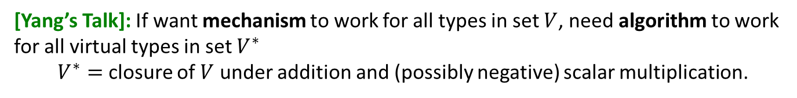
Recap
Agent 1
Input
Agent m
Input
…
Chosen Input 1
Mechanism that optimizes revenue
Algorithm that optimizes welfare
Want:
Output 1
Have:
…
Chosen Input k
Known Input
Output
Output k
Output
[Yang’s Talk]: If want mechanism to work for all types in set $V$, need algorithm to work for all virtual types in set $V^{∗}$
$V^{∗}=$ closure of $V$ under addition and (possibly negative) scalar multiplication.

Slide 4
Algorithm vs. Mechanism Design
Traditional Algorithm Design:
(given)
Input
Algorithm
(desired)
Output

Slide 5
Algorithm vs. Mechanism Design
Algorithmic Mechanism Design:
Agents’
Reports
Agents’
Payoffs
(given)
Input
Algorithm
(desired)
Output
Mechanism

Slide 6








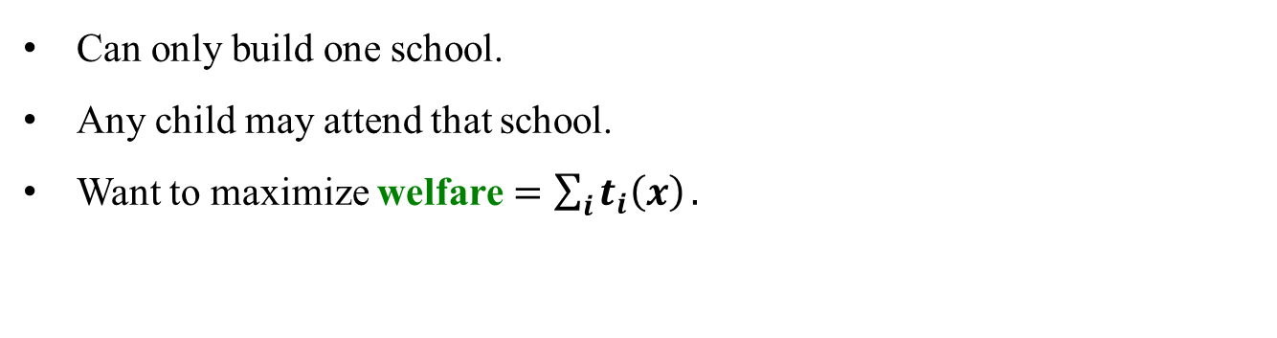
Example 1: building schools
1
1
…
…
i
j
…
…
m
n
Can only build one school.
Any child may attend that school.
Want to maximize welfare $=\sum_{i}{t_{i}\left(x\right)}.$

Slide 7



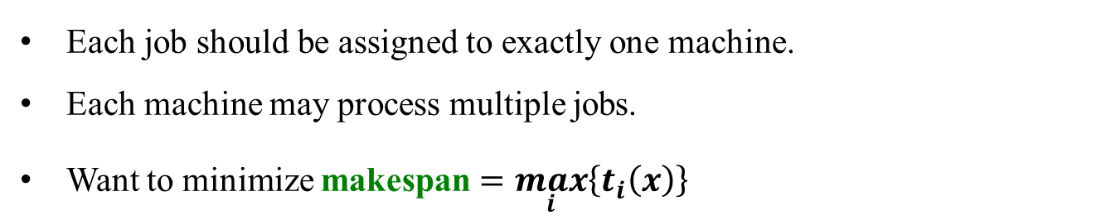
Example 2: scheduling jobs
1
1
…
…
i
j
…
…
m
n
Each job should be assigned to exactly one machine.
Each machine may process multiple jobs.
Want to minimize makespan $=\max_{i}\left\{t_{i}\left(x\right)\right\}$

Slide 8






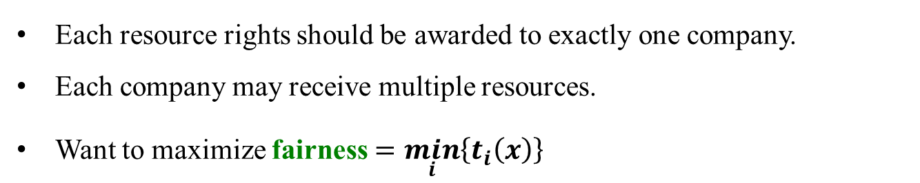
Example 3: dividing resources
1
1
…
…
i
j
…
…
m
n
Each resource rights should be awarded to exactly one company.
Each company may receive multiple resources.
Want to maximize fairness $=\min_{i}\left\{t_{i}\left(x\right)\right\}$

Slide 9


Algorithmic Mechanism Design
[Nisan-Ronen ’99]:
How much more difficult are optimization problems on “strategic” input compared to “honest” input?
The Dream:
Black-box reduction from mechanism- to algorithm-design for all optimization problems.
Agent 1
Input
Agent m
Input
…
Mechanism that works on strategic input
Algorithm that works on honest input
Want:
Have:
Known Input
Output
Output

Slide 10
Algorithmic Mechanism Design
[Nisan-Ronen ’99]:
How much more difficult are optimization problems on “strategic” input compared to “honest” input?
The Dream:
Black-box reduction from mechanism- to algorithm-design for all optimization problems.
Agent 1
Input
Agent m
Input
…
Chosen Input 1
Mechanism that works on strategic input
Algorithm that works on honest input
Want:
Output 1
Have:
…
Chosen Input k
Known Input
Output
Output k
Output

Slide 11
Why Black-Box Reductions?
Algorithmic
Mechanism Design
Algorithm Design
More is known about algorithms than mechanisms.
Hope: unsolved problems might reduce to already-solved problems.
Allows larger toolkit to tackle important problems.
Reduces to purely algorithmic problems.
Provides deeper understanding of Mechanism Design.
What makes incentives so difficult to deal with?
[This Talk] (informal): Reduction exists! (with right qualifications)

Slide 12
Reductions in Mechanism Design

Slide 13

Reducing Mechanism to Algorithm Design: Welfare
[Vickrey ‘61] + [Clarke ‘71] + [Groves ’73]: Optimal algorithm for welfare → optimal mechanism for welfare.
VCG Mechanism:
Each agent reports a type. Given as input to optimal algorithm.
Theorem: Exists payment scheme making this truthful (Clarke Pivot Rule).
For mechanism to work on all types in $V$, need algorithm for all types in $V$.
Agent 1
Input
Agent m
Input
…
Chosen Input 1
Mechanism that optimizes welfare
Algorithm that optimizes welfare
Want:
Output 1
Have:
…
Chosen Input k
Known Input
Output
Output k
Output

Slide 14
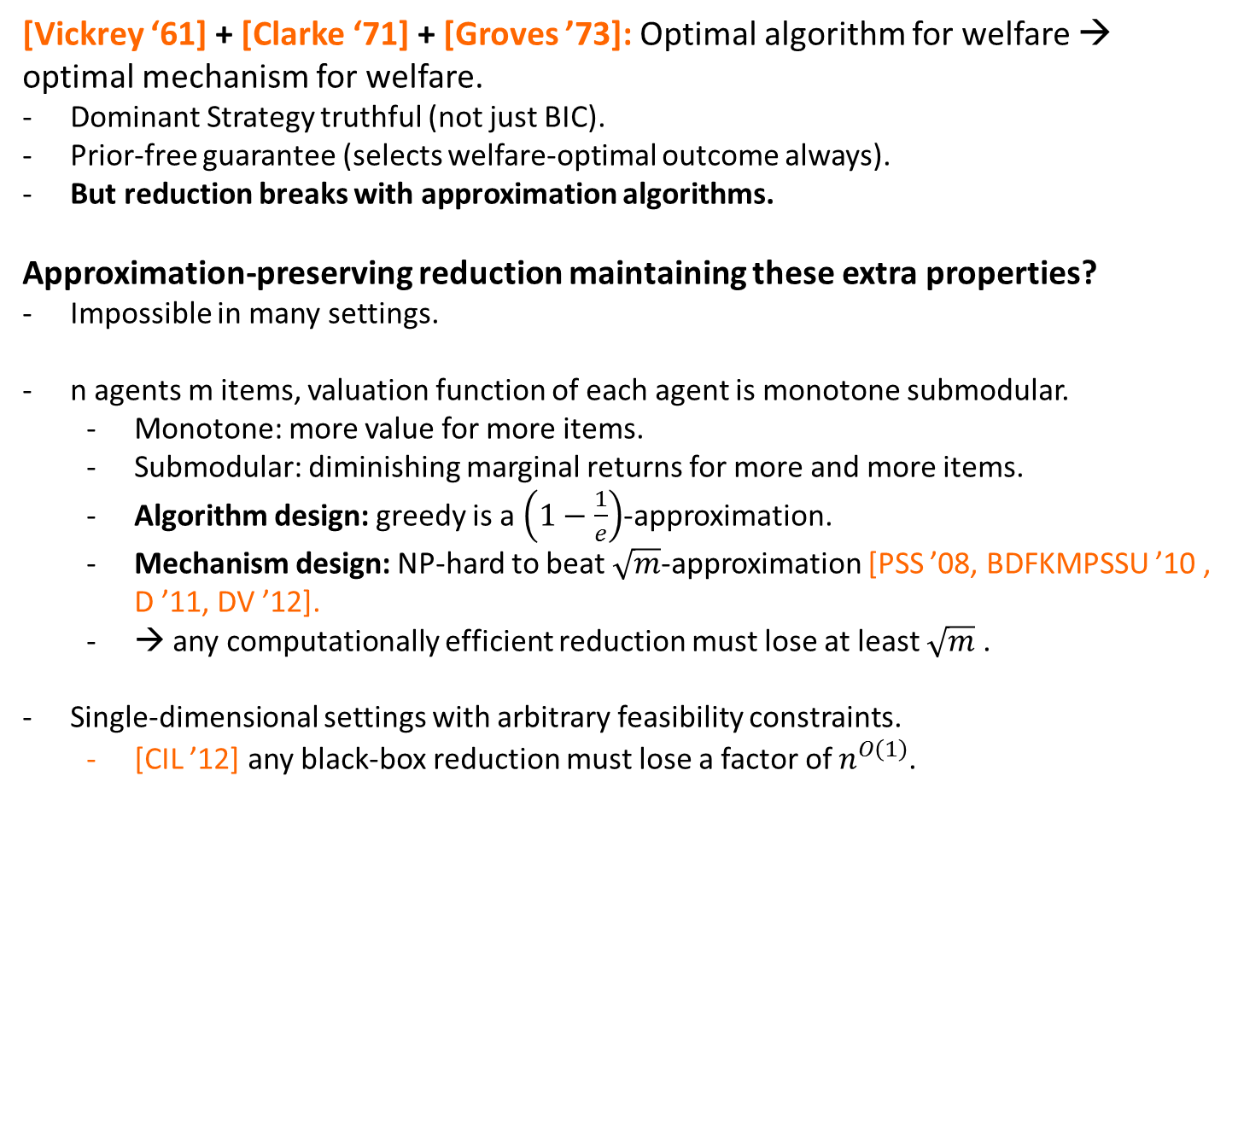
Reducing Mechanism to Algorithm Design: Welfare
[Vickrey ‘61] + [Clarke ‘71] + [Groves ’73]: Optimal algorithm for welfare → optimal mechanism for welfare.
Dominant Strategy truthful (not just BIC).
Prior-free guarantee (selects welfare-optimal outcome always).
But reduction breaks with approximation algorithms.
Approximation-preserving reduction maintaining these extra properties?
Impossible in many settings.
n agents m items, valuation function of each agent is monotone submodular.
Monotone: more value for more items.
Submodular: diminishing marginal returns for more and more items.
Algorithm design: greedy is a $\left(1−\frac{1}{e}\right)$-approximation.
Mechanism design: NP-hard to beat $\sqrt{m}$-approximation [PSS ’08, BDFKMPSSU ’10 , D ’11, DV ’12].
→ any computationally efficient reduction must lose at least $\sqrt{m}$ .
Single-dimensional settings with arbitrary feasibility constraints.
[CIL ’12] any black-box reduction must lose a factor of $n^{O\left(1\right)}$.

Slide 15
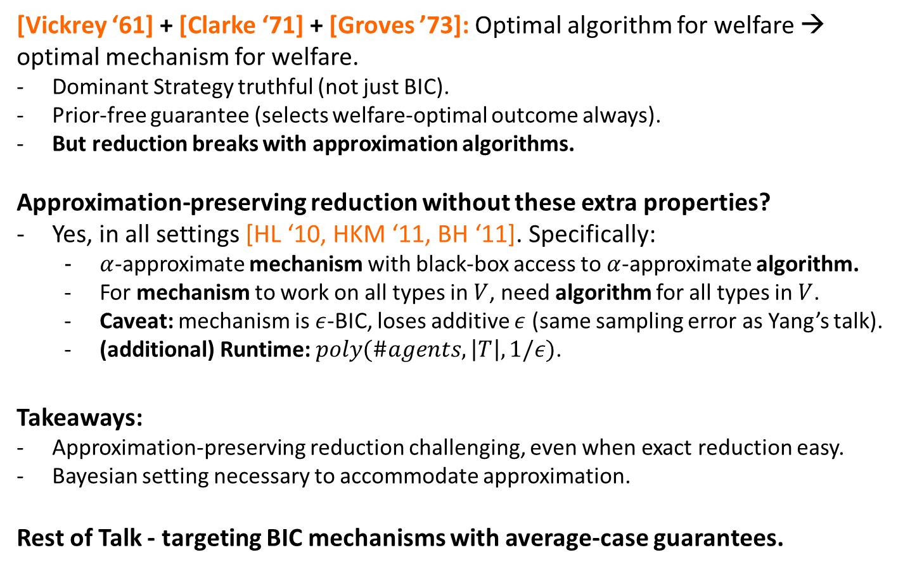
Reducing Mechanism to Algorithm Design: Welfare
[Vickrey ‘61] + [Clarke ‘71] + [Groves ’73]: Optimal algorithm for welfare → optimal mechanism for welfare.
Dominant Strategy truthful (not just BIC).
Prior-free guarantee (selects welfare-optimal outcome always).
But reduction breaks with approximation algorithms.
Approximation-preserving reduction without these extra properties?
Yes, in all settings [HL ‘10, HKM ‘11, BH ‘11]. Specifically:
$α$-approximate mechanism with black-box access to $α$-approximate algorithm.
For mechanism to work on all types in $V$, need algorithm for all types in $V$.
Caveat: mechanism is $ε$-BIC, loses additive $ε$ (same sampling error as Yang’s talk).
(additional) Runtime: $poly(\#agents,\left|T\right|, 1/ε)$.
Takeaways:
Approximation-preserving reduction challenging, even when exact reduction easy.
Bayesian setting necessary to accommodate approximation.
Rest of Talk - targeting BIC mechanisms with average-case guarantees.

Slide 16
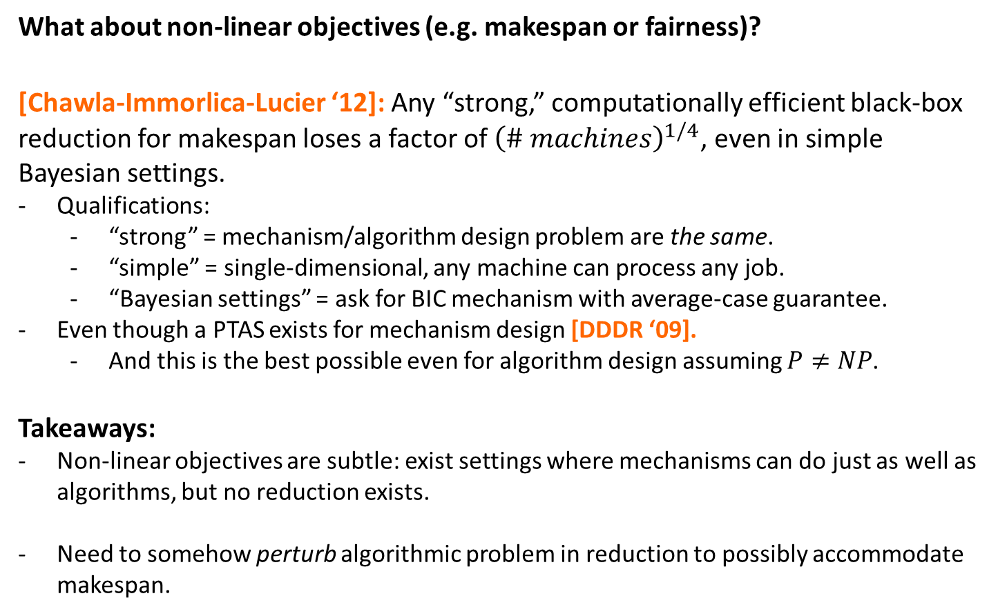
Reducing Mechanism to Algorithm Design: Makespan
What about non-linear objectives (e.g. makespan or fairness)?
[Chawla-Immorlica-Lucier ‘12]: Any “strong,” computationally efficient black-box reduction for makespan loses a factor of ${\left(\# machines\right)}^{1/4}$, even in simple Bayesian settings.
Qualifications:
“strong” = mechanism/algorithm design problem are the same.
“simple” = single-dimensional, any machine can process any job.
“Bayesian settings” = ask for BIC mechanism with average-case guarantee.
Even though a PTAS exists for mechanism design [DDDR ‘09].
And this is the best possible even for algorithm design assuming $P≠NP$.
Takeaways:
Non-linear objectives are subtle: exist settings where mechanisms can do just as well as algorithms, but no reduction exists.
Need to somehow perturb algorithmic problem in reduction to possibly accommodate makespan.

Slide 17


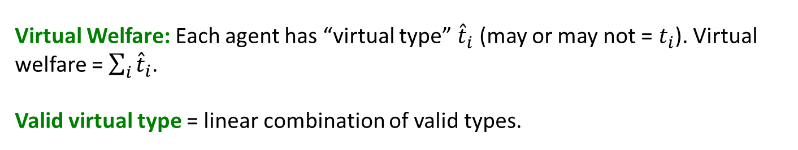
Reducing Mechanism to Algorithm Design
Mechanism Design Objective | Algorithm Design Objective
Welfare
Welfare [VCG, HL, HKM, BH]
Revenue
Virtual Welfare [Myerson, CDW]
General Objective $O$
Can’t be $O$! [CIL]
Virtual Welfare: Each agent has “virtual type” ${\hat{t}}_{i}$ (may or may not = $t_{i}$). Virtual welfare = $\sum_{i}{{\hat{t}}_{i}}$.
Valid virtual type = linear combination of valid types.

Slide 18

Reducing Mechanism to Algorithm Design
Mechanism Design Objective | Algorithm Design Objective
Welfare
Welfare [VCG, HL, HKM, BH]
Revenue
Virtual Welfare [Myerson, CDW]
General Objective $O$
$O$ + Virtual Welfare
[This Talk]
Virtual Welfare: Each agent has “virtual type” ${\hat{t}}_{i}$ (may or may not = $t_{i}$). Virtual welfare = $\sum_{i}{{\hat{t}}_{i}}$.
Valid virtual type = linear combination of valid types.

Slide 19












Main Result
Theorem [Cai-Daskalakis-W. ‘13b]: Polynomial-time reduction from mechanism design for objective O to algorithm design for same objective O plus virtual welfare.
Randomly assigns each agent a virtual type (computed by LP).
Inputs all types and virtual types to algorithm for $O$ + welfare.
Reported Types
Virtual Types
$$t_{1}$$
$$\hat{t_{1}}$$
Algorithm optimizing:
$$O\left(t_{1},t_{2},t_{3}\right)$$
$$+$$
$$Welfare\left(\hat{t_{1}},\hat{t_{2}},\hat{t_{3}}\right)$$
$$t_{2}$$
$$\hat{t_{2}}$$
$$t_{3}$$
$$\hat{t_{3}}$$

Slide 20
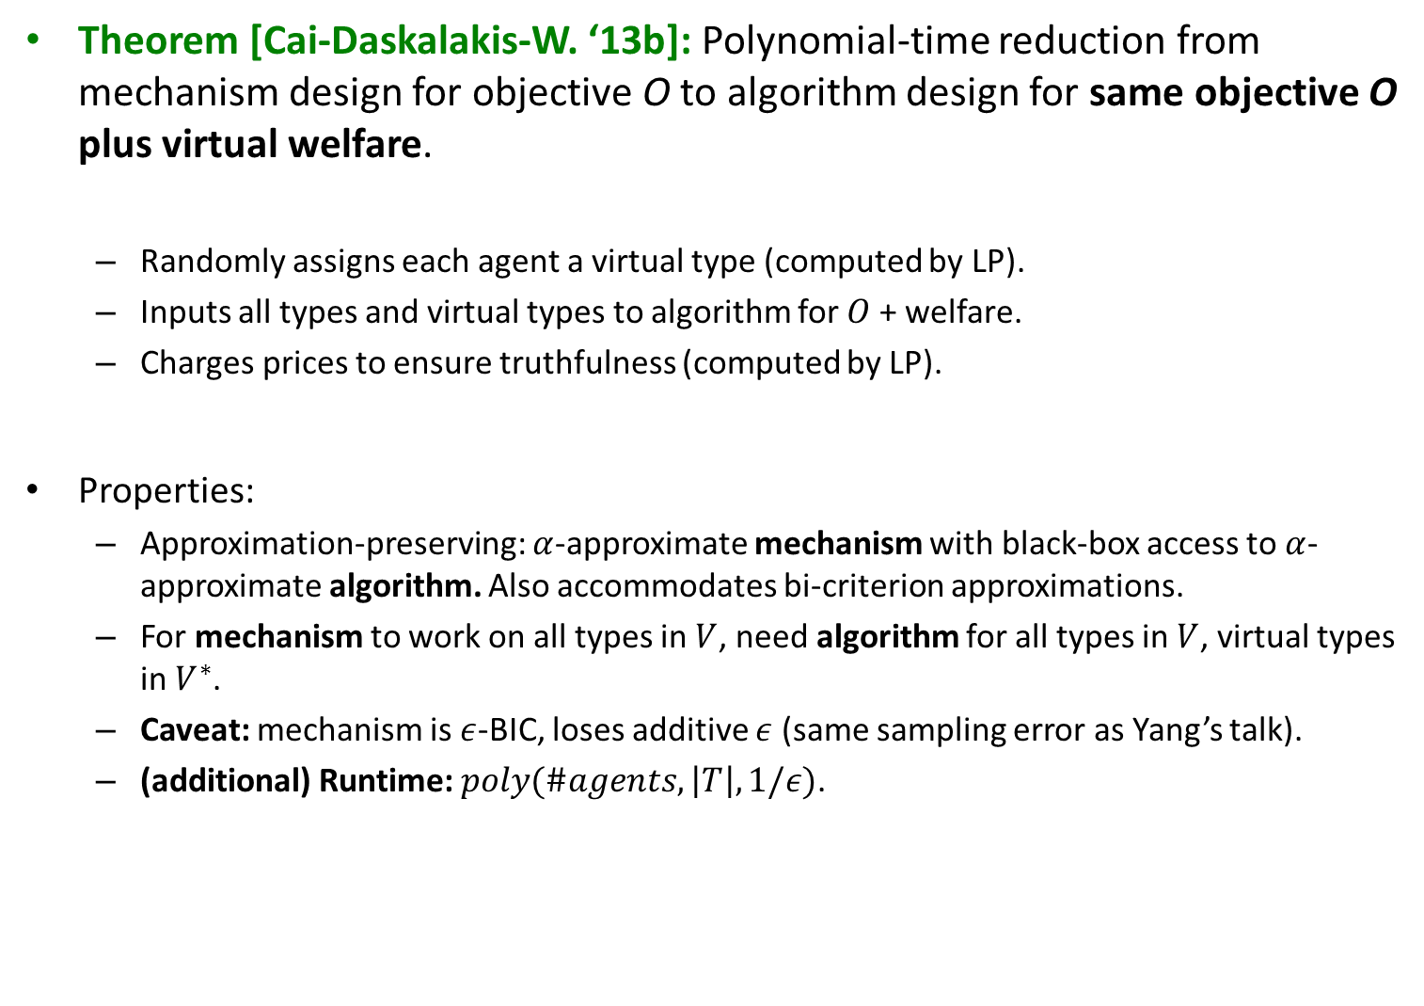
Main Result
Theorem [Cai-Daskalakis-W. ‘13b]: Polynomial-time reduction from mechanism design for objective O to algorithm design for same objective O plus virtual welfare.
Randomly assigns each agent a virtual type (computed by LP).
Inputs all types and virtual types to algorithm for $O$ + welfare.
Charges prices to ensure truthfulness (computed by LP).
Properties:
Approximation-preserving: $α$-approximate mechanism with black-box access to $α$-approximate algorithm. Also accommodates bi-criterion approximations.
For mechanism to work on all types in $V$, need algorithm for all types in $V$, virtual types in $V^{∗}$.
Caveat: mechanism is $ε$-BIC, loses additive $ε$ (same sampling error as Yang’s talk).
(additional) Runtime: $poly(\#agents,\left|T\right|, 1/ε)$.

Slide 21
Implicit Forms

Slide 22
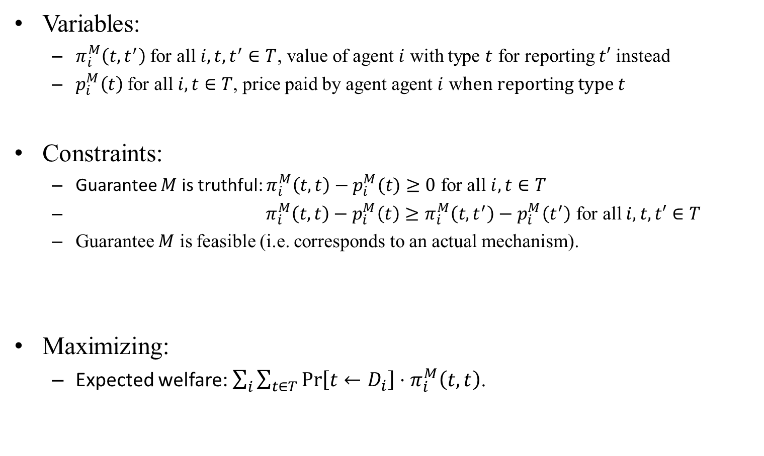
LP Using Implicit Form: Welfare
Variables:
$π_{i}^{M}\left(t,t^{′}\right)$ for all $i,t,t^{′}∈T$, value of agent $i$ with type $t$ for reporting $t′$ instead
$p_{i}^{M}\left(t\right)$ for all $i,t∈T$, price paid by agent agent $i$ w$hen reporting type t$
Constraints:
Guarantee $M$ is truthful: $π_{i}^{M}\left(t,t\right)−p_{i}^{M}(t)≥0$ for all $i, t∈T$
$π_{i}^{M}\left(t,t\right)−p_{i}^{M}\left(t\right)≥π_{i}^{M}\left(t,t^{′}\right)−p_{i}^{M}\left(t^{′}\right)$ for all $i, t,t′∈T$
Guarantee $M$ is feasible (i.e. corresponds to an actual mechanism).
Maximizing:
Expected welfare: $\sum_{i}{\sum_{t∈T}{\operatorname{Pr}\left[t←D_{i}\right]⋅π_{i}^{M}\left(t,t\right)}}$.

Slide 23
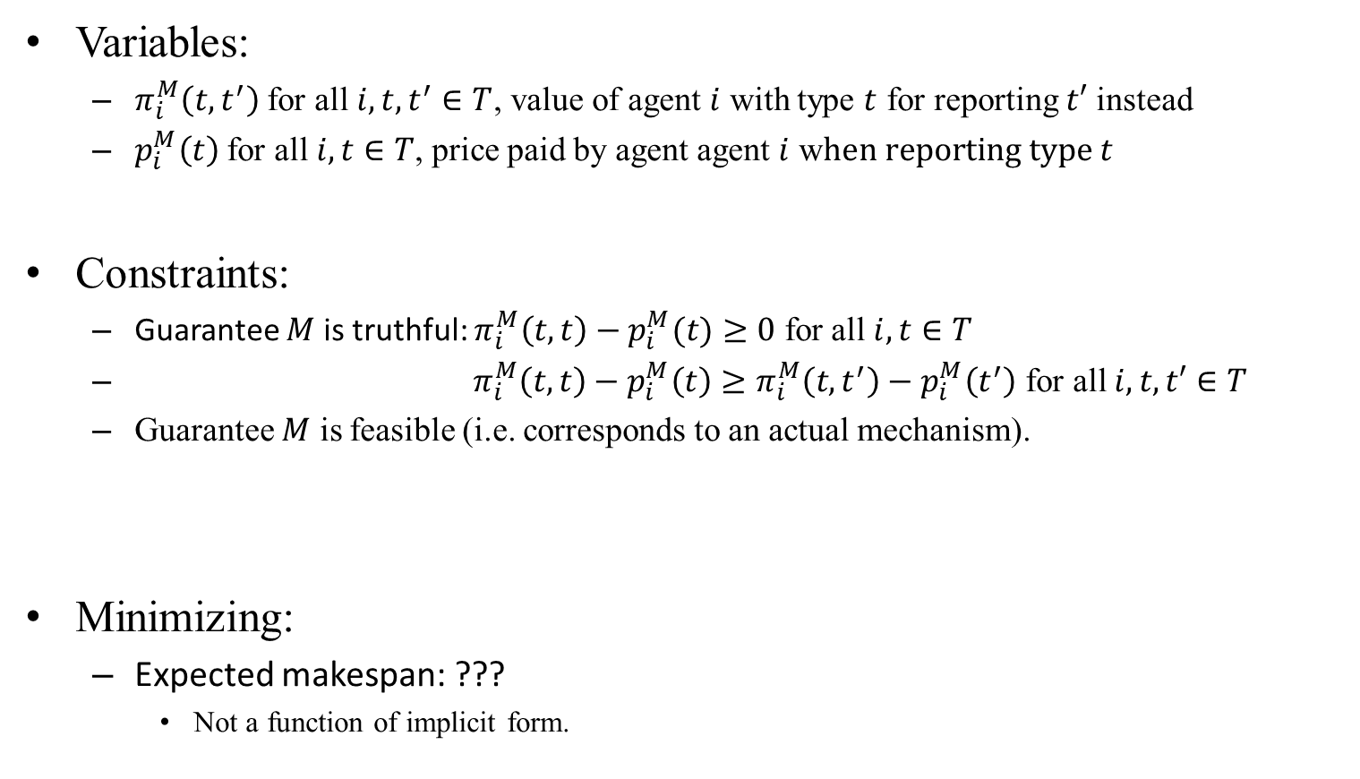
LP Using Implicit Form: Makespan
Variables:
$π_{i}^{M}\left(t,t^{′}\right)$ for all $i,t,t^{′}∈T$, value of agent $i$ with type $t$ for reporting $t′$ instead
$p_{i}^{M}\left(t\right)$ for all $i,t∈T$, price paid by agent agent $i$ w$hen reporting type t$
Constraints:
Guarantee $M$ is truthful: $π_{i}^{M}\left(t,t\right)−p_{i}^{M}(t)≥0$ for all $i, t∈T$
$π_{i}^{M}\left(t,t\right)−p_{i}^{M}\left(t\right)≥π_{i}^{M}\left(t,t^{′}\right)−p_{i}^{M}\left(t^{′}\right)$ for all $i, t,t′∈T$
Guarantee $M$ is feasible (i.e. corresponds to an actual mechanism).
Minimizing:
Expected makespan: ???
Not a function of implicit form.

Slide 24
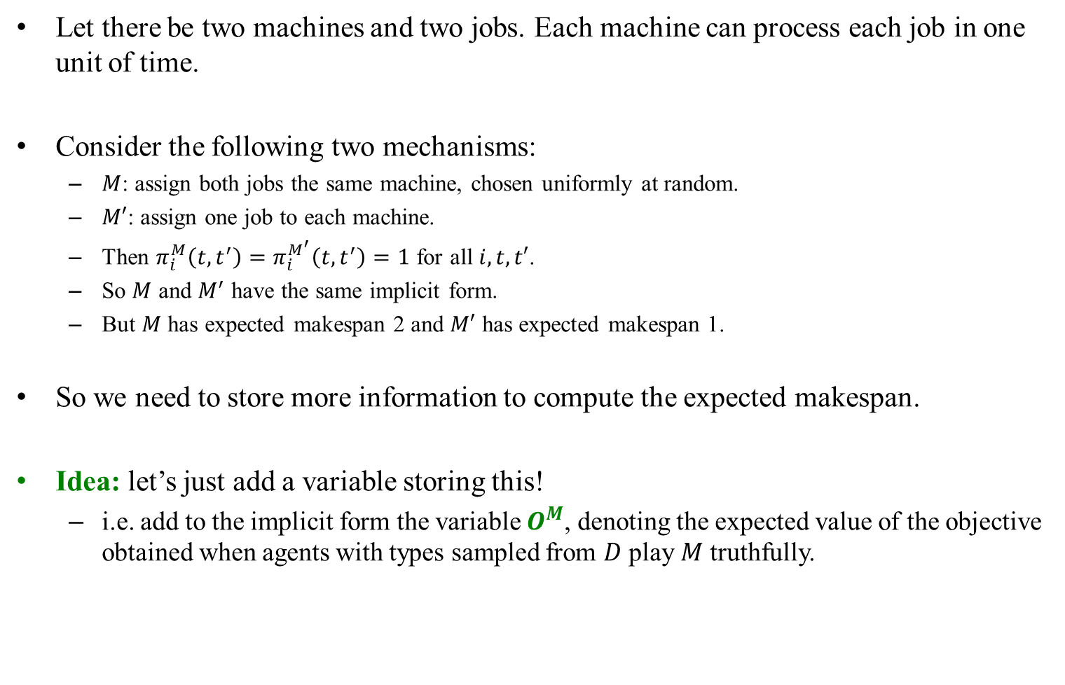
Implicit Forms & Makespan: Example
Let there be two machines and two jobs. Each machine can process each job in one unit of time.
Consider the following two mechanisms:
$M$: assign both jobs the same machine, chosen uniformly at random.
$M′$: assign one job to each machine.
Then $π_{i}^{M}\left(t, t^{′}\right)=π_{i}^{M^{′}}\left(t, t^{′}\right)=1$ for all $i, t, t′$.
So $M$ and $M^{′}$ have the same implicit form.
But $M$ has expected makespan 2 and $M′$ has expected makespan 1.
So we need to store more information to compute the expected makespan.
Idea: let’s just add a variable storing this!
i.e. add to the implicit form the variable $O^{M}$, denoting the expected value of the objective obtained when agents with types sampled from $D$ play $M$ truthfully.

Slide 25
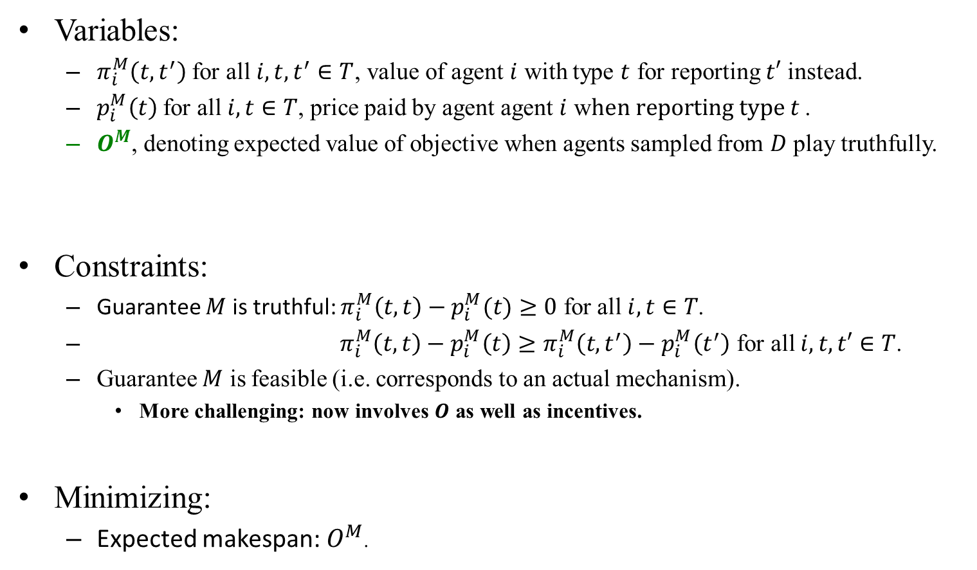
LP Using Implicit Form: Makespan
Variables:
$π_{i}^{M}\left(t,t^{′}\right)$ for all $i,t,t^{′}∈T$, value of agent $i$ with type $t$ for reporting $t′$ instead.
$p_{i}^{M}\left(t\right)$ for all $i,t∈T$, price paid by agent agent $i$ w$hen reporting type t$ .
$O^{M}$, denoting expected value of objective when agents sampled from $D$ play truthfully.
Constraints:
Guarantee $M$ is truthful: $π_{i}^{M}\left(t,t\right)−p_{i}^{M}(t)≥0$ for all $i, t∈T$.
$π_{i}^{M}\left(t,t\right)−p_{i}^{M}\left(t\right)≥π_{i}^{M}\left(t,t^{′}\right)−p_{i}^{M}\left(t^{′}\right)$ for all $i, t,t′∈T$.
Guarantee $M$ is feasible (i.e. corresponds to an actual mechanism).
More challenging: now involves $O$ as well as incentives.
Minimizing:
Expected makespan: $O^{M}$.

Slide 26



Feasibility of (new) Implicit Forms
What question are we asking now?
Example: Two jobs, two agents, each with two types.
A = processes either job in one unit of time.
B = processes either job in two units of time.
Is there a mechanism matching all of these guarantees?
Yes: assign one job to each machine no matter what.
1/2
$$A π_{1}\left(A,A\right)=1$$
$$π_{1}\left(A,B\right)=1$$
$π_{1}\left(B,A\right)=2$
$$B π_{1}\left(B,B\right)=2$$
$$π_{2}\left(A,A\right)=1 A$$
$$π_{2}\left(A,B\right)=1$$
$$π_{2}\left(B, A\right)=2$$
$$π_{2}\left(B, B\right)=2 B$$
1/2
Agent 1
Agent 2
1/2
1/2
$$O=1.75$$

Slide 27
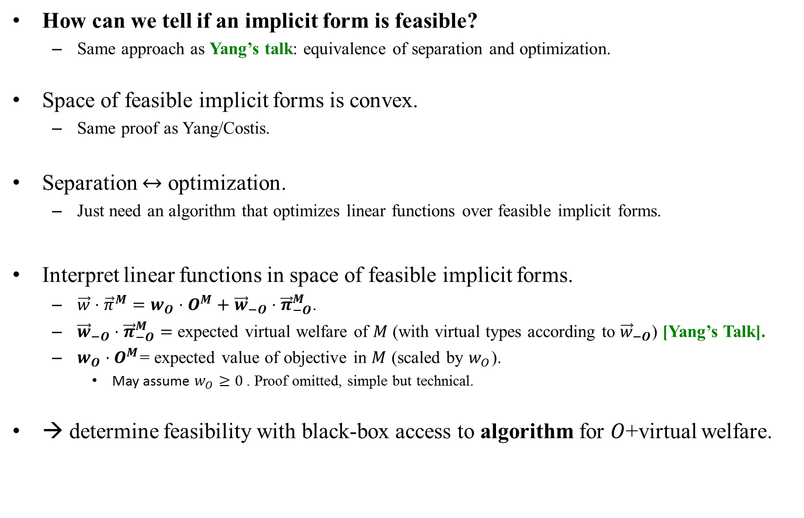
Feasibility of (new) Implicit Forms
How can we tell if an implicit form is feasible?
Same approach as Yang’s talk: equivalence of separation and optimization.
Space of feasible implicit forms is convex.
Same proof as Yang/Costis.
Separation $↔$ optimization.
Just need an algorithm that optimizes linear functions over feasible implicit forms.
Interpret linear functions in space of feasible implicit forms.
$\vec{w}⋅{\vec{π}}^{M}=w_{O}⋅O^{M}+{\vec{w}}_{−O}⋅{\vec{π}}_{−O}^{M}$.
${\vec{w}}_{−O}⋅{\vec{π}}_{−O}^{M}=$ expected virtual welfare of $M$ (with virtual types according to ${\vec{w}}_{−O}$) [Yang’s Talk].
$w_{O}⋅O^{M}$= expected value of objective in $M$ (scaled by $w_{O}$).
May assume $w_{O}≥0$. Proof omitted, simple but technical.
→ determine feasibility with black-box access to algorithm for $O$+virtual welfare.

Slide 28
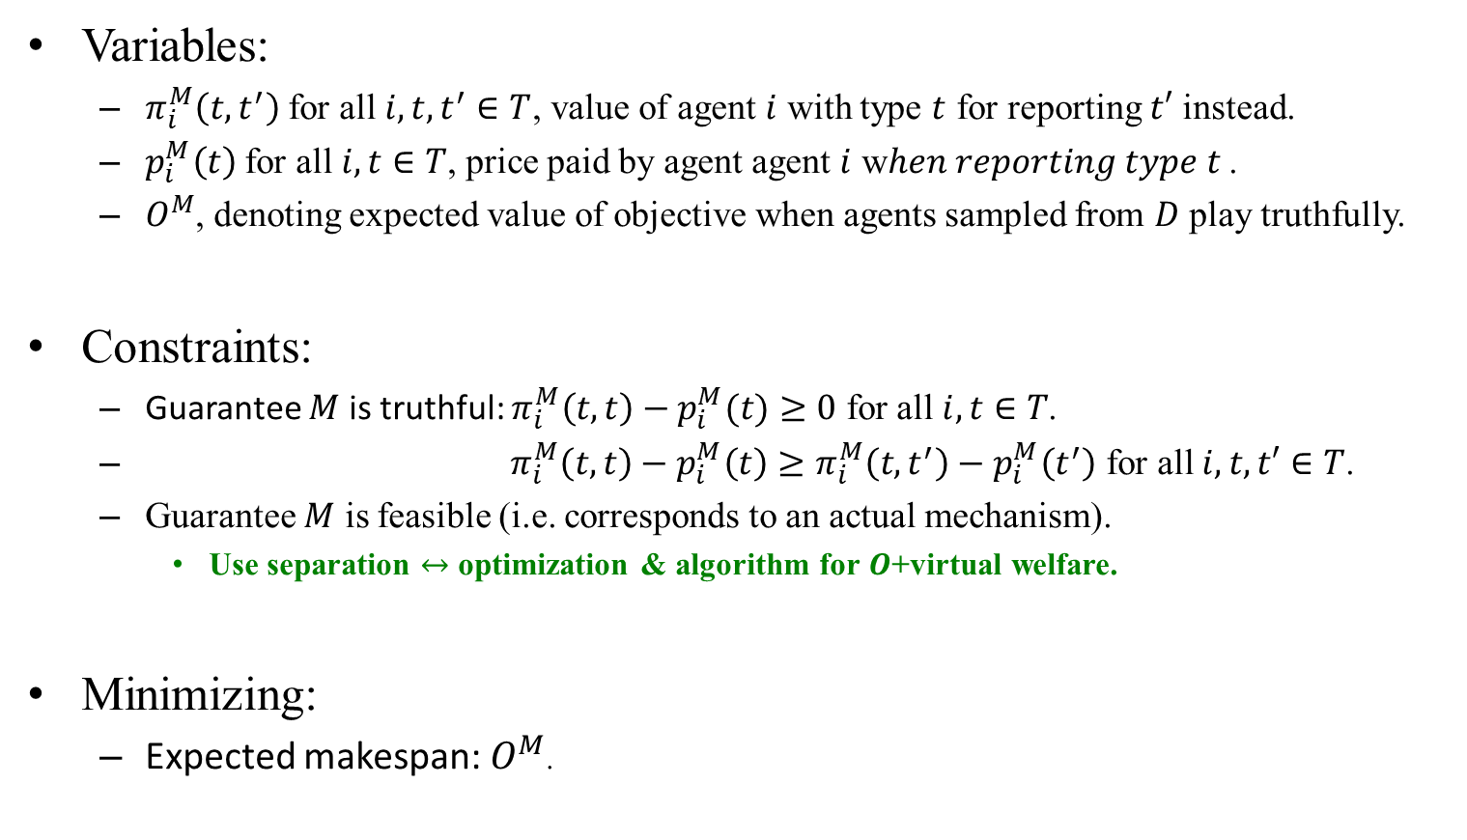
LP Using Implicit Form: Makespan
Variables:
$π_{i}^{M}\left(t,t^{′}\right)$ for all $i,t,t^{′}∈T$, value of agent $i$ with type $t$ for reporting $t′$ instead.
$p_{i}^{M}\left(t\right)$ for all $i,t∈T$, price paid by agent agent $i$ w$hen reporting type t$ .
$O^{M}$, denoting expected value of objective when agents sampled from $D$ play truthfully.
Constraints:
Guarantee $M$ is truthful: $π_{i}^{M}\left(t,t\right)−p_{i}^{M}(t)≥0$ for all $i, t∈T$.
$π_{i}^{M}\left(t,t\right)−p_{i}^{M}\left(t\right)≥π_{i}^{M}\left(t,t^{′}\right)−p_{i}^{M}\left(t^{′}\right)$ for all $i, t,t′∈T$.
Guarantee $M$ is feasible (i.e. corresponds to an actual mechanism).
Use separation $↔$ optimization & algorithm for $O$+virtual welfare.
Minimizing:
Expected makespan: $O^{M}$.

Slide 29
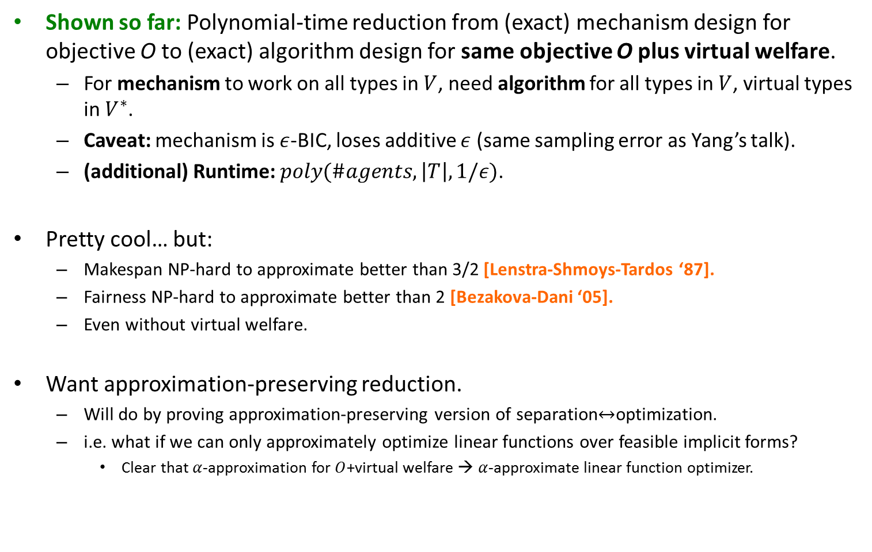
Recap
Shown so far: Polynomial-time reduction from (exact) mechanism design for objective O to (exact) algorithm design for same objective O plus virtual welfare.
For mechanism to work on all types in $V$, need algorithm for all types in $V$, virtual types in $V^{∗}$.
Caveat: mechanism is $ε$-BIC, loses additive $ε$ (same sampling error as Yang’s talk).
(additional) Runtime: $poly(\#agents,\left|T\right|, 1/ε)$.
Pretty cool… but:
Makespan NP-hard to approximate better than 3/2 [Lenstra-Shmoys-Tardos ‘87].
Fairness NP-hard to approximate better than 2 [Bezakova-Dani ‘05].
Even without virtual welfare.
Want approximation-preserving reduction.
Will do by proving approximation-preserving version of separation$↔$optimization.
i.e. what if we can only approximately optimize linear functions over feasible implicit forms?
Clear that $α$-approximation for $O$+virtual welfare → $α$-approximate linear function optimizer.

Slide 30
Approximate Equivalence of Separation and Optimization

Slide 31


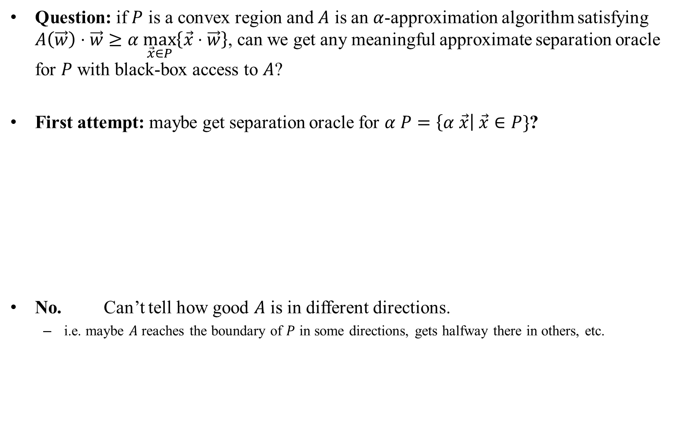
Approximate Equivalence of Separation and Optimization
Question: if $P$ is a convex region and $A$ is an $α$-approximation algorithm satisfying $A\left(\vec{w}\right)⋅\vec{w}≥α \max_{\vec{x}∈P}\left\{\vec{x}⋅\vec{w}\right\}$, can we get any meaningful approximate separation oracle for $P$ with black-box access to $A$?
First attempt: maybe get separation oracle for $α P=\left\{α \vec{x}\right| \vec{x}∈P\}$?
No. Can’t tell how good $A$ is in different directions.
i.e. maybe $A$ reaches the boundary of $P$ in some directions, gets halfway there in others, etc.
$$α P$$

Slide 32

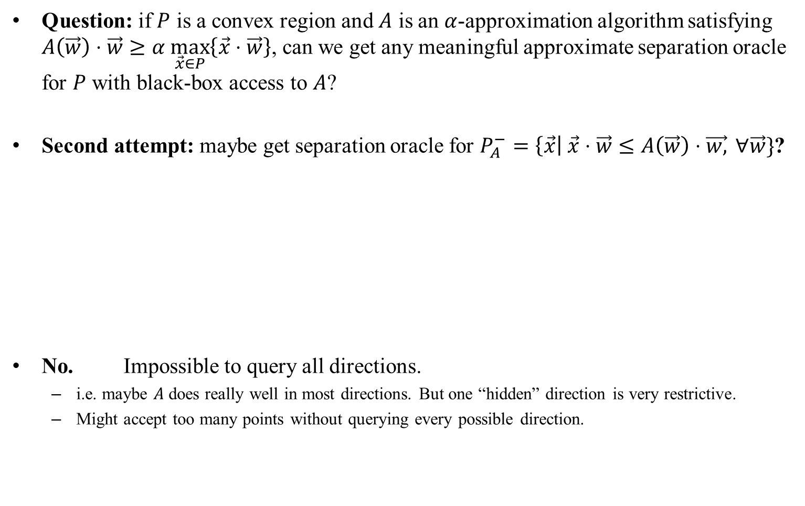
Approximate Equivalence of Separation and Optimization
Question: if $P$ is a convex region and $A$ is an $α$-approximation algorithm satisfying $A\left(\vec{w}\right)⋅\vec{w}≥α \max_{\vec{x}∈P}\left\{\vec{x}⋅\vec{w}\right\}$, can we get any meaningful approximate separation oracle for $P$ with black-box access to $A$?
Second attempt: maybe get separation oracle for $P_{A}^{−}=\left\{\vec{x}\right| \vec{x}⋅\vec{w}≤A\left(\vec{w}\right)⋅\vec{w,} ∀\vec{w}\}$?
No. Impossible to query all directions.
i.e. maybe $A$ does really well in most directions. But one “hidden” direction is very restrictive.
Might accept too many points without querying every possible direction.
$$P_{A}^{−}$$

Slide 33

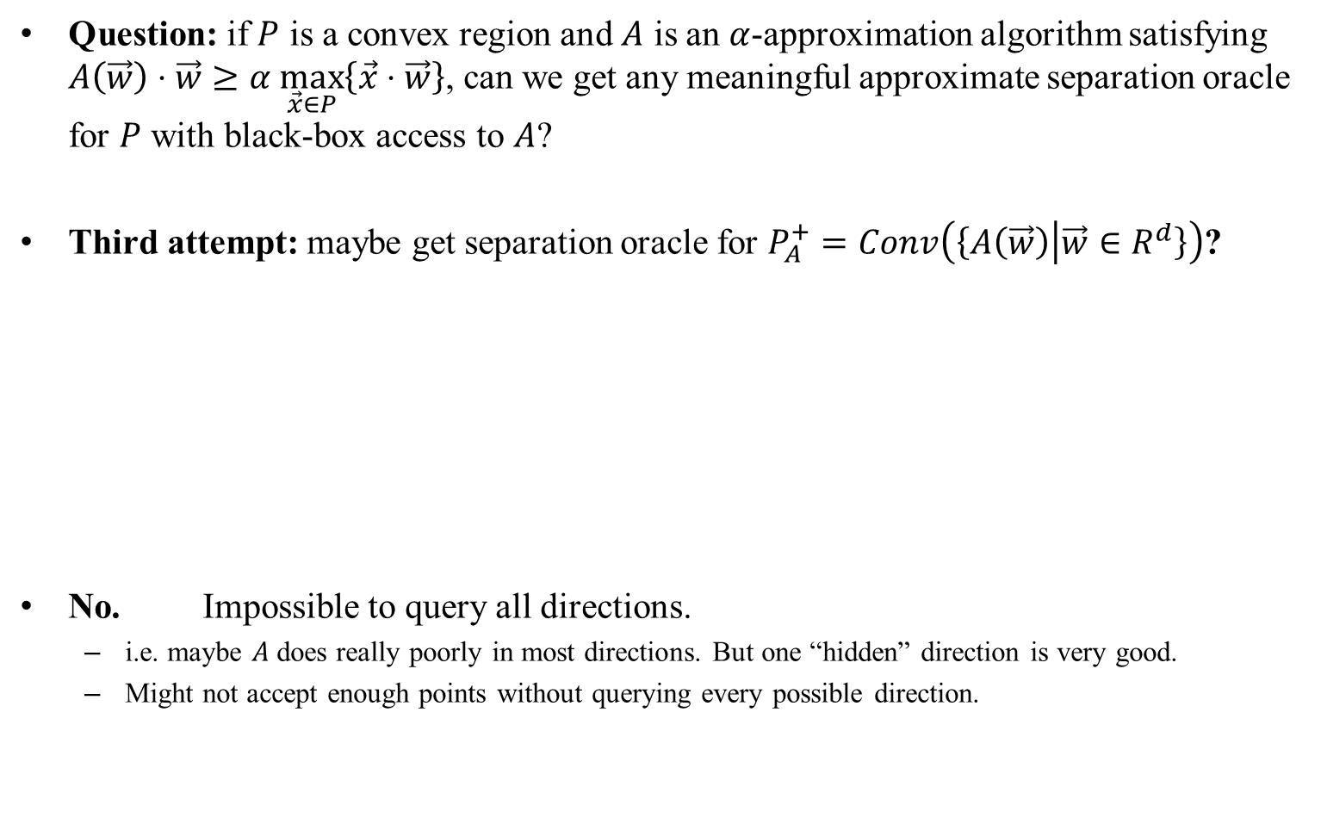
Approximate Equivalence of Separation and Optimization
Question: if $P$ is a convex region and $A$ is an $α$-approximation algorithm satisfying $A\left(\vec{w}\right)⋅\vec{w}≥α \max_{\vec{x}∈P}\left\{\vec{x}⋅\vec{w}\right\}$, can we get any meaningful approximate separation oracle for $P$ with black-box access to $A$?
Third attempt: maybe get separation oracle for $P_{A}^{+}=Conv\left(\left\{A\left(\vec{w}\right) | \vec{w}∈R^{d}\right\}\right)$?
No. Impossible to query all directions.
i.e. maybe $A$ does really poorly in most directions. But one “hidden” direction is very good.
Might not accept enough points without querying every possible direction.
$$P_{A}^{+}$$

Slide 34


Approximate Equivalence of Separation and Optimization
Question: if $P$ is a convex region and $A$ is an $α$-approximation algorithm satisfying $A\left(\vec{w}\right)⋅\vec{w}≥α \max_{\vec{x}∈P}\left\{\vec{x}⋅\vec{w}\right\}$, can we get any meaningful approximate separation oracle for $P$ with black-box access to $A$?
Next attempt: forget about convex regions. Use $A$ instead of an exact optimization algorithm inside separation $↔$ optimization and hope for the best.
Interestingly, this works.
$$"Yes"$$

Slide 35
Recap: Equivalence of Separation and Optimization
Theorem [Grotschel-Lovasz-Schrijver, Karp-Papadamitriou ‘81]: Optimize linear functions over $P→$ separation oracle for $P$
Proof: Write a program to search for possible hyperplanes violated by input $\vec{x}$:
Variables: $t,\vec{w}$
Type 1 Constraints: $\vec{w}∈{\left[−1,1\right]}^{d}$ ($d=$dimension)
Type 2 Constraints: $t≥\vec{w}⋅\vec{y,} ∀\vec{y}∈P$
Maximizing: $\vec{x}⋅\vec{w}−t$
Call output ${\vec{w}}^{∗},t^{∗}$
If $\vec{x}⋅{\vec{w}}^{∗}−t^{∗}>0?$ Then explicitly found violated hyperplane. Output ${\vec{w}}^{∗},t^{∗}$
Otherwise? $\vec{x}⋅\vec{w}≤max_{\vec{y}∈P}\left\{\vec{y}⋅\vec{w}\right\} ∀\vec{w}∈{\left[−1,1\right]}^{d}$, and therefore $\vec{x}∈P$. Output “Yes.”
Infinitely many (or at least exponentially many) type 2 constraints.
Use a separation oracle!
Let ${\vec{y}}^{∗}=argmax_{\vec{y}∈P}\left\{\vec{w}⋅\vec{y}\right\}$.
If $t≥\vec{w}⋅{\vec{y}}^{∗}$, then all type 2 constraints satisfied. Output “Yes.”
If not, found explicit violated hyperplane. Output ${\vec{y}}^{∗}$
Find ${\vec{y}}^{∗}$ via optimization algorithm!

Slide 36
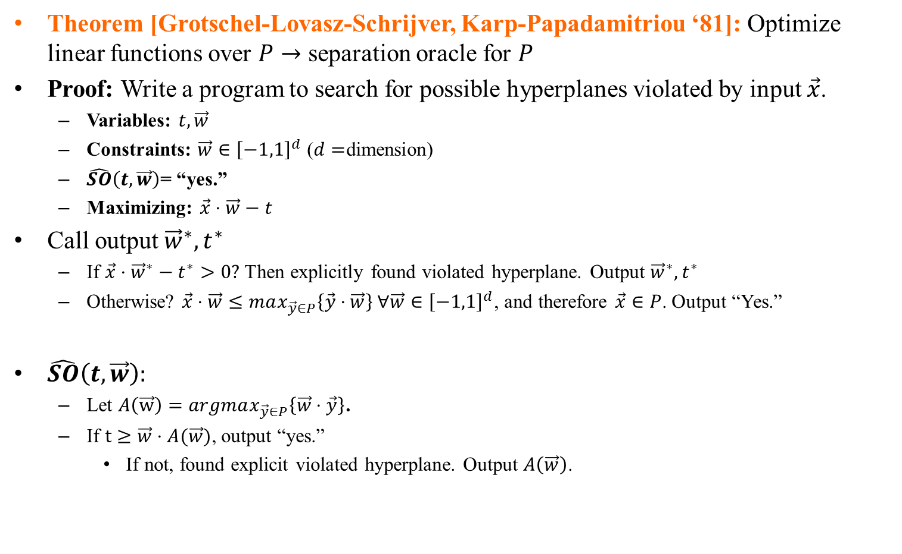
Recap: Equivalence of Separation and Optimization
Theorem [Grotschel-Lovasz-Schrijver, Karp-Papadamitriou ‘81]: Optimize linear functions over $P→$ separation oracle for $P$
Proof: Write a program to search for possible hyperplanes violated by input $\vec{x}$.
Variables: $t,\vec{w}$
Constraints: $\vec{w}∈{\left[−1,1\right]}^{d}$ ($d=$dimension)
$\hat{SO}\left(t, \vec{w}\right)$= “yes.”
Maximizing: $\vec{x}⋅\vec{w}−t$
Call output ${\vec{w}}^{∗},t^{∗}$
If $\vec{x}⋅{\vec{w}}^{∗}−t^{∗}>0?$ Then explicitly found violated hyperplane. Output ${\vec{w}}^{∗},t^{∗}$
Otherwise? $\vec{x}⋅\vec{w}≤max_{\vec{y}∈P}\left\{\vec{y}⋅\vec{w}\right\} ∀\vec{w}∈{\left[−1,1\right]}^{d}$, and therefore $\vec{x}∈P$. Output “Yes.”
$\hat{SO}\left(t, \vec{w}\right):$
Let $A\left(\vec{w}\right)=argmax_{\vec{y}∈P}\left\{\vec{w}⋅\vec{y}\right\}$.
If $t≥\vec{w}⋅A(\vec{w})$, output “yes.”
If not, found explicit violated hyperplane. Output $A\left(\vec{w}\right)$.

Slide 37
Recap: Equivalence of Separation and Optimization
Theorem [Grotschel-Lovasz-Schrijver, Karp-Papadamitriou ‘81]: Optimize linear functions over $P→$ separation oracle for $P$
Proof: Write a program to search for possible hyperplanes violated by input $\vec{x}$.
Variables: $t,\vec{w}$
Constraints: $\vec{w}∈{\left[−1,1\right]}^{d}$ ($d=$dimension)
$\hat{SO}\left(t, \vec{w}\right)$= “yes.”
Maximizing: $\vec{x}⋅\vec{w}−t$
Call output ${\vec{w}}^{∗},t^{∗}$
If $\vec{x}⋅{\vec{w}}^{∗}−t^{∗}>0?$ Then explicitly found violated hyperplane. Output ${\vec{w}}^{∗},t^{∗}$
Otherwise? $\vec{x}⋅\vec{w}≤max_{\vec{y}∈P}\left\{\vec{y}⋅\vec{w}\right\} ∀\vec{w}∈{\left[−1,1\right]}^{d}$, and therefore $\vec{x}∈P$. Output “Yes.”
$\hat{SO}\left(t, \vec{w}\right):$
Let $A\left(\vec{w}\right)=argmax_{\vec{y}∈P}\left\{\vec{w}⋅\vec{y}\right\}$.
If $t≥\vec{w}⋅A(\vec{w})$, output “yes.”
If not, found explicit violated hyperplane. Output $A\left(\vec{w}\right)$.

Slide 38

Recap: Equivalence of Separation and Optimization
Theorem [Grotschel-Lovasz-Schrijver, Karp-Papadamitriou ‘81]: Optimize linear functions over $P→$ separation oracle for $P$
Proof: Write a program to search for possible hyperplanes violated by input $\vec{x}$.
Variables: $t,\vec{w}$
Constraints: $\vec{w}∈{\left[−1,1\right]}^{d}$ ($d=$dimension)
$\hat{SO}\left(t, \vec{w}\right)$= “yes.”
Maximizing: $\vec{x}⋅\vec{w}−t$
Call output ${\vec{w}}^{∗},t^{∗}$
If $\vec{x}⋅{\vec{w}}^{∗}−t^{∗}>0?$ Then explicitly found violated hyperplane. Output ${\vec{w}}^{∗},t^{∗}$
Otherwise? $\vec{x}⋅\vec{w}≤max_{\vec{y}∈P}\left\{\vec{y}⋅\vec{w}\right\} ∀\vec{w}∈{\left[−1,1\right]}^{d}$, and therefore $\vec{x}∈P$. Output “Yes.”
$\hat{SO}\left(t, \vec{w}\right):$
Let $A\left(\vec{w}\right)≥α⋅argmax_{\vec{y}∈P}\left\{\vec{w}⋅\vec{y}\right\}$.
If $t≥\vec{w}⋅A(\vec{w})$, output “yes.”
If not, found explicit violated hyperplane. Output $A\left(\vec{w}\right)$.

Slide 39
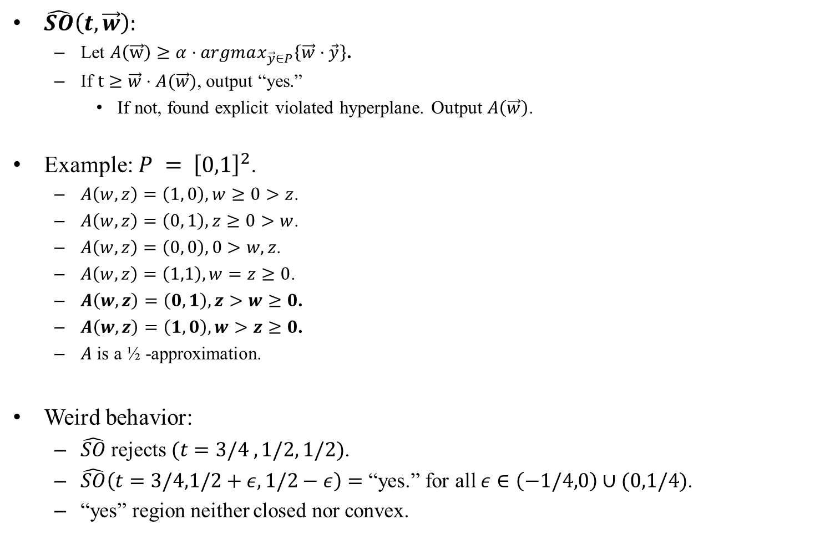
Approximate Equivalence of Separation and Optimization
$\hat{SO}\left(t, \vec{w}\right):$
Let $A\left(\vec{w}\right)≥α⋅argmax_{\vec{y}∈P}\left\{\vec{w}⋅\vec{y}\right\}$.
If $t≥\vec{w}⋅A(\vec{w})$, output “yes.”
If not, found explicit violated hyperplane. Output $A\left(\vec{w}\right)$.
Example: $P = {\left[0,1\right]}^{2}$.
$A\left(w,z\right)=\left(1, 0\right), w≥0>z$.
$A\left(w,z\right)=\left(0, 1\right), z≥0>w$.
$A\left(w,z\right)=\left(0, 0\right), 0>w,z$.
$A\left(w, z\right)=\left(1,1\right), w=z≥0$.
$A\left(w,z\right)=\left(0,1\right), z>w≥0$.
$A\left(w,z\right)=\left(1,0\right), w>z≥0$.
$A$ is a ½ -approximation.
Weird behavior:
$\hat{SO}$ rejects $(t=3/4 ,1/2, 1/2)$.
$\hat{SO}\left(t=3/4,1/2+ε,1/2−ε\right)=$ “yes.” for all $ε∈\left(−1/4,0\right)∪(0,1/4)$.
“yes” region neither closed nor convex.

Slide 40


Approximate Equivalence of Separation and Optimization
$\hat{SO}\left(t, \vec{w}\right):$
Let $A\left(\vec{w}\right)≥α⋅argmax_{\vec{y}∈P}\left\{\vec{w}⋅\vec{y}\right\}$.
If $t≥\vec{w}⋅A(\vec{w})$, output “yes.”
If not, found explicit violated hyperplane. Output $A\left(\vec{w}\right)$.
Causes SO to have similar behavior.
Call Weird Separation Oracle.
Still sometimes says “yes,” sometimes outputs hyperplanes.
But “yes” region is no longer closed or convex.
$$"Yes"$$

Slide 41
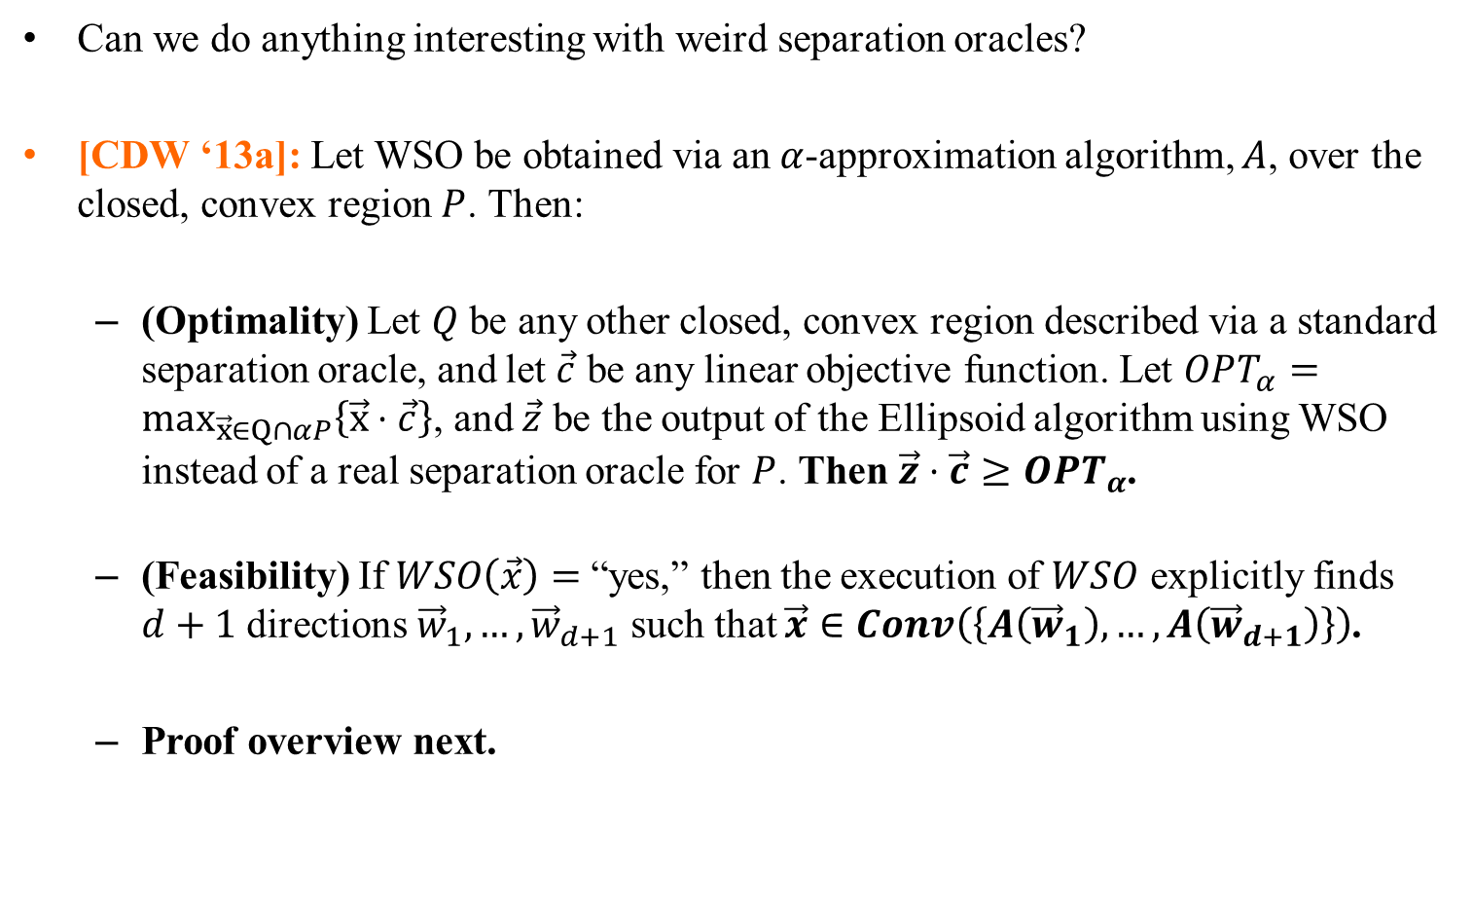
Approximate Equivalence of Separation and Optimization
Can we do anything interesting with weird separation oracles?
[CDW ‘13a]: Let WSO be obtained via an $α$-approximation algorithm, $A$, over the closed, convex region $P$. Then:
(Optimality) Let $Q$ be any other closed, convex region described via a standard separation oracle, and let $\vec{c}$ be any linear objective function. Let $OPT_{α}=max_{\vec{x}∈Q∩αP}\left\{\vec{x}⋅\vec{c}\right\}$, and $\vec{z}$ be the output of the Ellipsoid algorithm using WSO instead of a real separation oracle for $P$. Then $\vec{z}⋅\vec{c}≥OPT_{α}$.
(Feasibility) If $WSO\left(\vec{x}\right)=$“yes,” then the execution of $WSO$ explicitly finds $d+1$ directions ${\vec{w}}_{1},…,{\vec{w}}_{d+1}$ such that $\vec{x}∈Conv\left(\left\{A\left({\vec{w}}_{1}\right), …, A\left({\vec{w}}_{d+1}\right)\right\}\right)$.
Proof overview next.

Slide 42
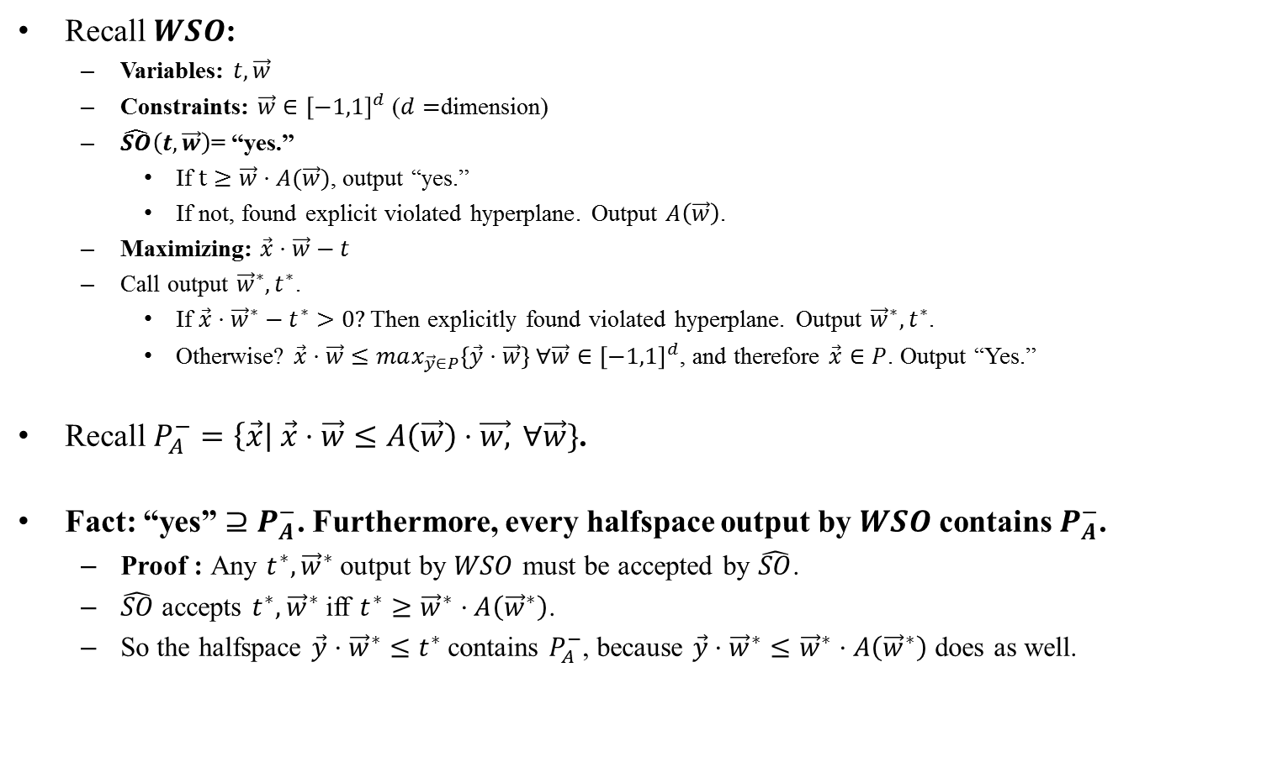
Approximate Equivalence of Separation and Optimization
Recall $WSO$:
Variables: $t,\vec{w}$
Constraints: $\vec{w}∈{\left[−1,1\right]}^{d}$ ($d=$dimension)
$\hat{SO}\left(t, \vec{w}\right)$= “yes.”
If $t≥\vec{w}⋅A(\vec{w})$, output “yes.”
If not, found explicit violated hyperplane. Output $A\left(\vec{w}\right)$.
Maximizing: $\vec{x}⋅\vec{w}−t$
Call output ${\vec{w}}^{∗},t^{∗}$.
If $\vec{x}⋅{\vec{w}}^{∗}−t^{∗}>0?$ Then explicitly found violated hyperplane. Output ${\vec{w}}^{∗},t^{∗}$.
Otherwise? $\vec{x}⋅\vec{w}≤max_{\vec{y}∈P}\left\{\vec{y}⋅\vec{w}\right\} ∀\vec{w}∈{\left[−1,1\right]}^{d}$, and therefore $\vec{x}∈P$. Output “Yes.”
Recall $P_{A}^{−}=\left\{\vec{x}\right| \vec{x}⋅\vec{w}≤A\left(\vec{w}\right)⋅\vec{w,} ∀\vec{w}\}$.
Fact: “yes” $⊇P_{A}^{−}$. Furthermore, every halfspace output by $WSO$ contains $P_{A}^{−}$.
Proof : Any $t^{∗},{\vec{w}}^{∗}$ output by $WSO$ must be accepted by $\hat{SO}$.
$\hat{SO}$ accepts $t^{∗}, {\vec{w}}^{∗}$ iff $t^{∗}≥{\vec{w}}^{∗}⋅A\left({\vec{w}}^{∗}\right)$.
So the halfspace $\vec{y}⋅{\vec{w}}^{∗}≤t^{∗}$contains $P_{A}^{−}$, because $\vec{y}⋅{\vec{w}}^{∗}≤{\vec{w}}^{∗}⋅A\left({\vec{w}}^{∗}\right)$ does as well.

Slide 43
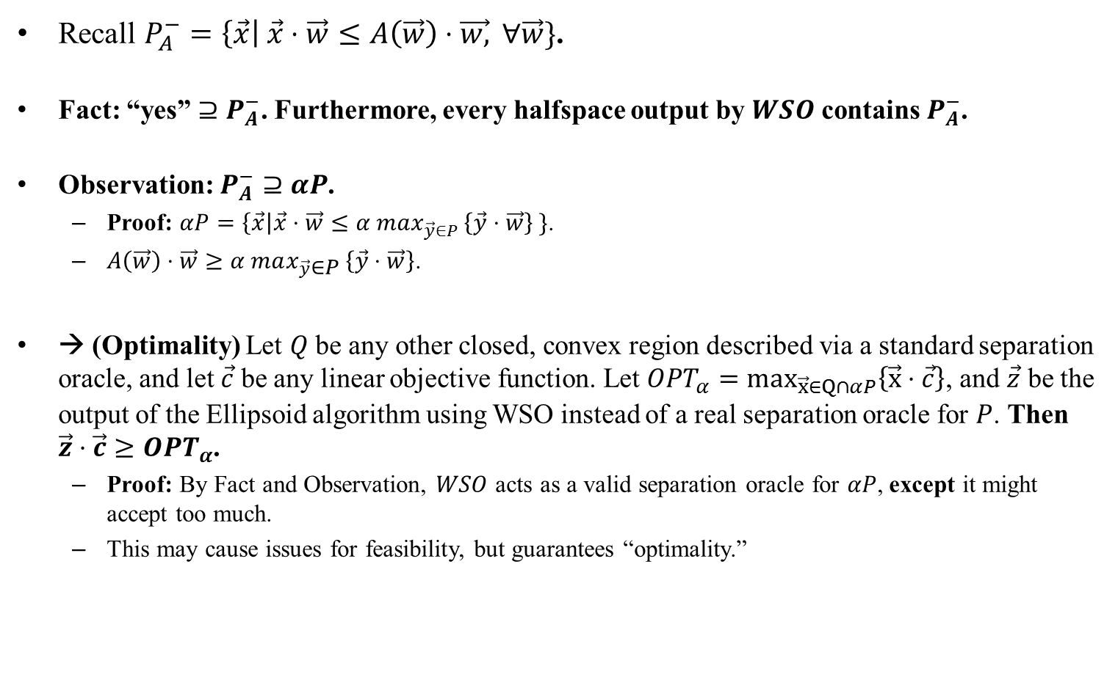
Approximate Equivalence of Separation and Optimization
Recall $P_{A}^{−}=\left\{\vec{x}\right| \vec{x}⋅\vec{w}≤A\left(\vec{w}\right)⋅\vec{w,} ∀\vec{w}\}$.
Fact: “yes” $⊇P_{A}^{−}$. Furthermore, every halfspace output by $WSO$ contains $P_{A}^{−}$.
Observation: $P_{A}^{−}⊇αP$.
Proof: $αP=\left\{\vec{x}\right|\vec{x}⋅\vec{w}≤α max_{\vec{y}∈P }\left\{\vec{y}⋅\vec{w}\right\} \}$.
$A\left(\vec{w}\right)⋅\vec{w}≥α max_{\vec{y}∈P }\left\{\vec{y}⋅\vec{w}\right\}$.
→ (Optimality) Let $Q$ be any other closed, convex region described via a standard separation oracle, and let $\vec{c}$ be any linear objective function. Let $OPT_{α}=max_{\vec{x}∈Q∩αP}\left\{\vec{x}⋅\vec{c}\right\}$, and $\vec{z}$ be the output of the Ellipsoid algorithm using WSO instead of a real separation oracle for $P$. Then $\vec{z}⋅\vec{c}≥OPT_{α}$.
Proof: By Fact and Observation, $WSO$ acts as a valid separation oracle for $αP$, except it might accept too much.
This may cause issues for feasibility, but guarantees “optimality.”

Slide 44
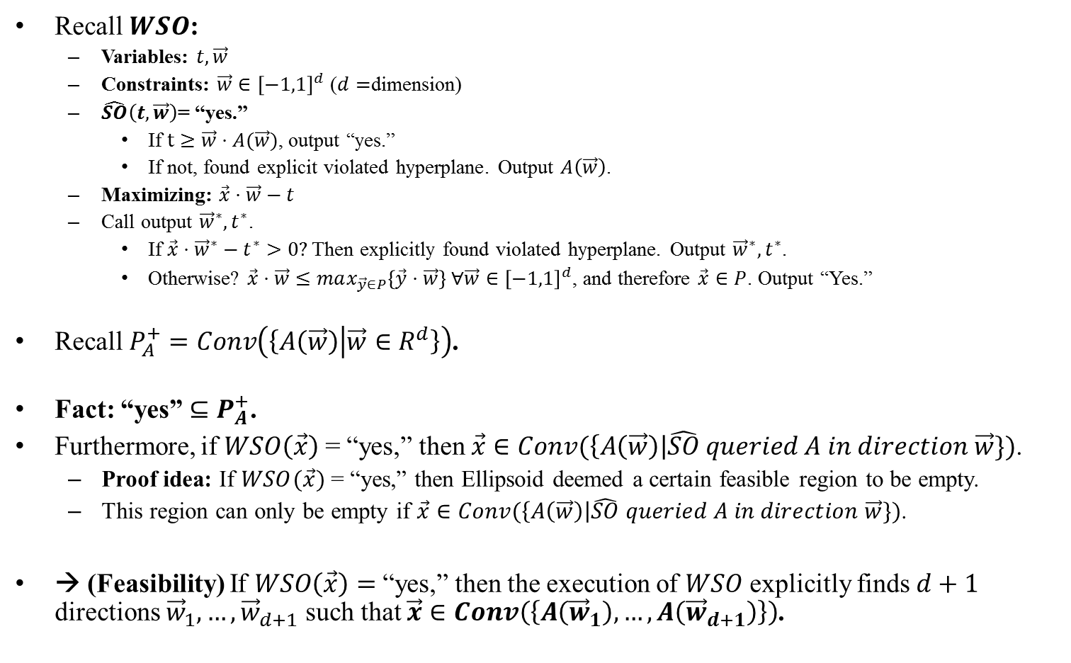
Approximate Equivalence of Separation and Optimization
Recall $WSO$:
Variables: $t,\vec{w}$
Constraints: $\vec{w}∈{\left[−1,1\right]}^{d}$ ($d=$dimension)
$\hat{SO}\left(t, \vec{w}\right)$= “yes.”
If $t≥\vec{w}⋅A(\vec{w})$, output “yes.”
If not, found explicit violated hyperplane. Output $A\left(\vec{w}\right)$.
Maximizing: $\vec{x}⋅\vec{w}−t$
Call output ${\vec{w}}^{∗},t^{∗}$.
If $\vec{x}⋅{\vec{w}}^{∗}−t^{∗}>0?$ Then explicitly found violated hyperplane. Output ${\vec{w}}^{∗},t^{∗}$.
Otherwise? $\vec{x}⋅\vec{w}≤max_{\vec{y}∈P}\left\{\vec{y}⋅\vec{w}\right\} ∀\vec{w}∈{\left[−1,1\right]}^{d}$, and therefore $\vec{x}∈P$. Output “Yes.”
Recall $P_{A}^{+}=Conv\left(\left\{A\left(\vec{w}\right) | \vec{w}∈R^{d}\right\}\right)$.
Fact: “yes” $⊆P_{A}^{+}$.
Furthermore, if $WSO\left(\vec{x}\right)$ = “yes,” then $\vec{x}∈Conv(\left\{A\left(\vec{w}\right)\right|\hat{SO} queried A in direction \vec{w}\})$.
Proof idea: If $WSO(\vec{x})$ = “yes,” then Ellipsoid deemed a certain feasible region to be empty.
This region can only be empty if $\vec{x}∈Conv(\left\{A\left(\vec{w}\right)\right|\hat{SO} queried A in direction \vec{w}\})$.
→ (Feasibility) If $WSO\left(\vec{x}\right)=$“yes,” then the execution of $WSO$ explicitly finds $d+1$ directions ${\vec{w}}_{1},…,{\vec{w}}_{d+1}$ such that $\vec{x}∈Conv\left(\left\{A\left({\vec{w}}_{1}\right), …, A\left({\vec{w}}_{d+1}\right)\right\}\right)$.

Slide 45




Approximate Equivalence of Separation and Optimization
[CDW ‘13a]: Let WSO be obtained via an $α$-approximation algorithm, $A$, over the closed, convex region $P$. Then:
(Optimality) Let $Q$ be any other closed, convex region described via a standard separation oracle, and let $\vec{c}$ be any linear objective function. Let $OPT_{α}=max_{\vec{x}∈Q∩αP}\left\{\vec{x}⋅\vec{c}\right\}$, and $\vec{z}$ be the output of the Ellipsoid algorithm using WSO instead of a real separation oracle for $P$. Then $\vec{z}⋅\vec{c}≥OPT_{α}$.
(Feasibility) If $WSO\left(\vec{x}\right)=$“yes,” then the execution of $WSO$ explicitly finds $d+1$ directions ${\vec{w}}_{1},…,{\vec{w}}_{d+1}$ such that $\vec{x}∈Conv\left(\left\{A\left({\vec{w}}_{1}\right), …, A\left({\vec{w}}_{d+1}\right)\right\}\right)$.
$$=P_{α}^{−}$$
$=$ “yes”
$$=P_{α}^{+}$$

Slide 46
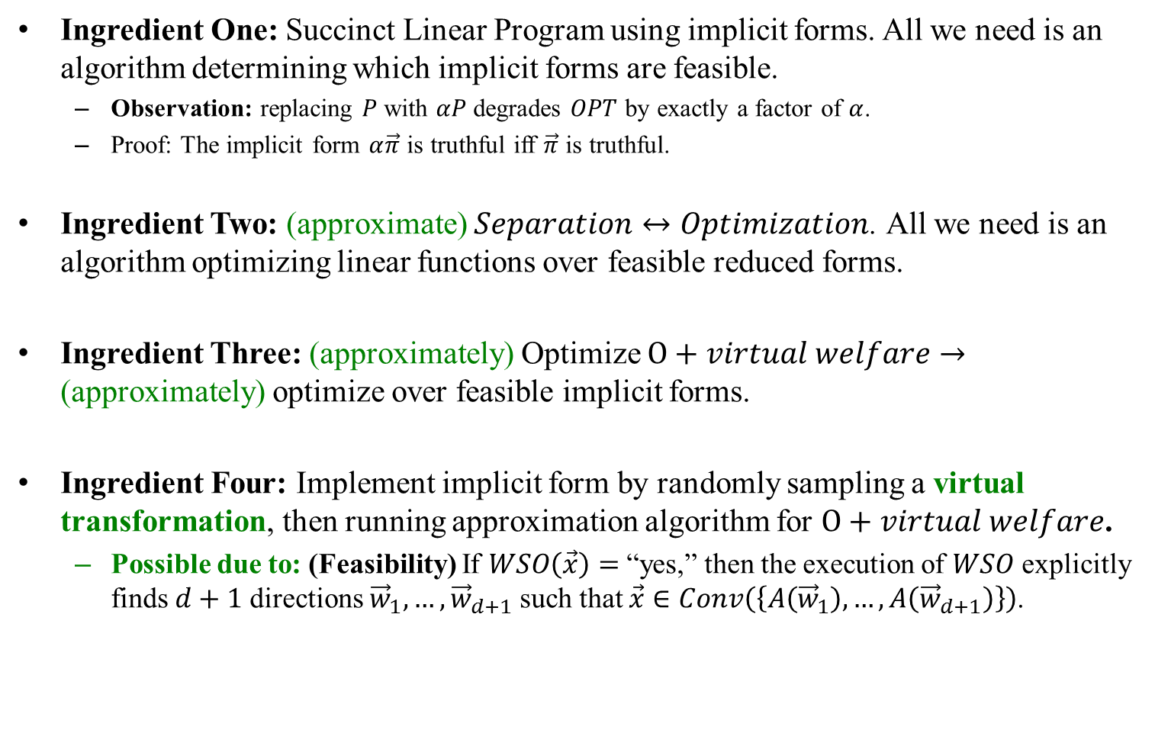
Back to Mechanism Design
Ingredient One: Succinct Linear Program using implicit forms. All we need is an algorithm determining which implicit forms are feasible.
Observation: replacing $P$ with $αP$ degrades $OPT$ by exactly a factor of $α$.
Proof: The implicit form $α\vec{π}$ is truthful iff $\vec{π}$ is truthful.
Ingredient Two: (approximate) $Separation↔Optimization$. All we need is an algorithm optimizing linear functions over feasible reduced forms.
Ingredient Three: (approximately) Optimize $O+virtual welfare→$ (approximately) optimize over feasible implicit forms.
Ingredient Four: Implement implicit form by randomly sampling a virtual transformation, then running approximation algorithm for $O+virtual welfare$.
Possible due to: (Feasibility) If $WSO\left(\vec{x}\right)=$“yes,” then the execution of $WSO$ explicitly finds $d+1$ directions ${\vec{w}}_{1},…,{\vec{w}}_{d+1}$ such that $\vec{x}∈Conv\left(\left\{A\left({\vec{w}}_{1}\right), …, A\left({\vec{w}}_{d+1}\right)\right\}\right)$.

Slide 47
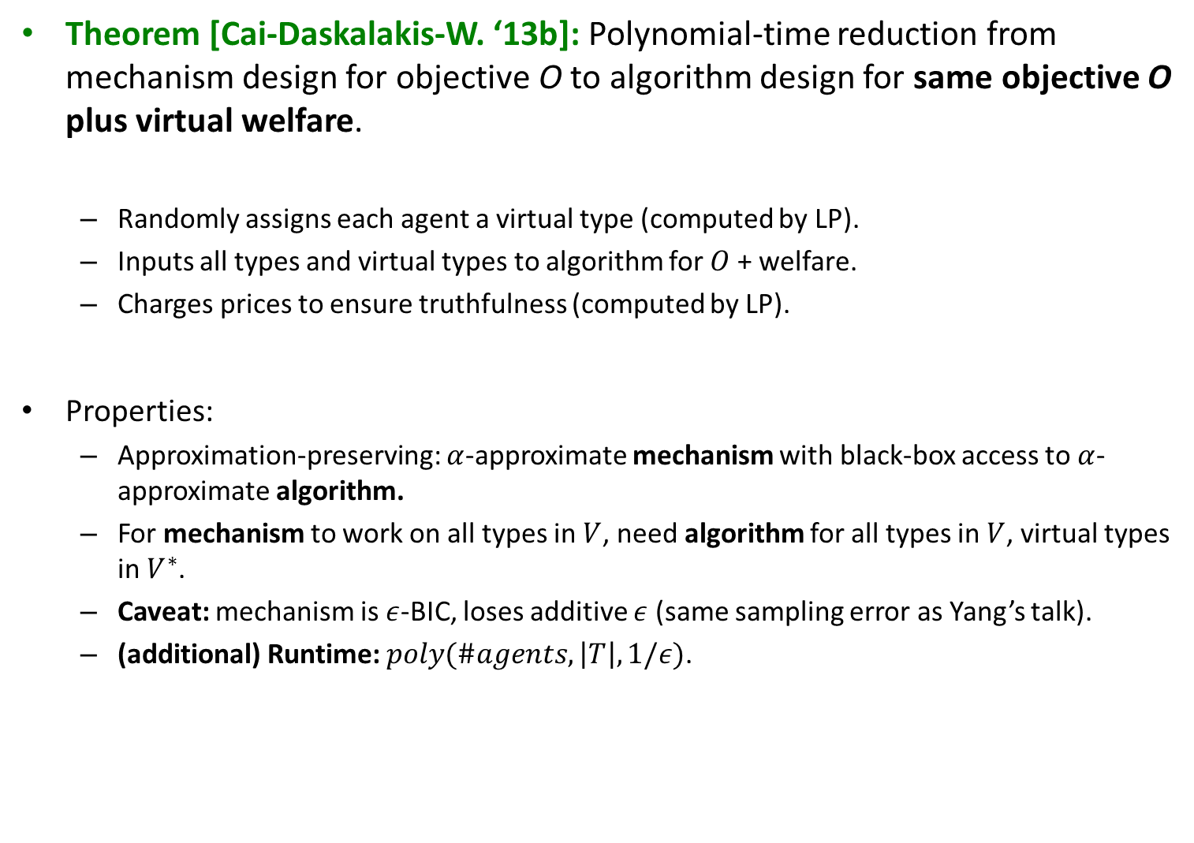
Back to Mechanism Design
Theorem [Cai-Daskalakis-W. ‘13b]: Polynomial-time reduction from mechanism design for objective O to algorithm design for same objective O plus virtual welfare.
Randomly assigns each agent a virtual type (computed by LP).
Inputs all types and virtual types to algorithm for $O$ + welfare.
Charges prices to ensure truthfulness (computed by LP).
Properties:
Approximation-preserving: $α$-approximate mechanism with black-box access to $α$-approximate algorithm.
For mechanism to work on all types in $V$, need algorithm for all types in $V$, virtual types in $V^{∗}$.
Caveat: mechanism is $ε$-BIC, loses additive $ε$ (same sampling error as Yang’s talk).
(additional) Runtime: $poly(\#agents,\left|T\right|, 1/ε)$.

Slide 48
Let’s Apply It?

Slide 49




Example: selling doctor appointments
Slots
1
…
…
…
time
i
…
…
…
m
…
Want to maximize revenue.
No slot should be given to more than one bidder.
No bidder should get more than one slot with the same doctor, or overlapping slots with different doctors.
Feasibility constraints form a 3D-matching.
So greedy algorithm yields a 1/3-approximation for virtual welfare.

Slide 50
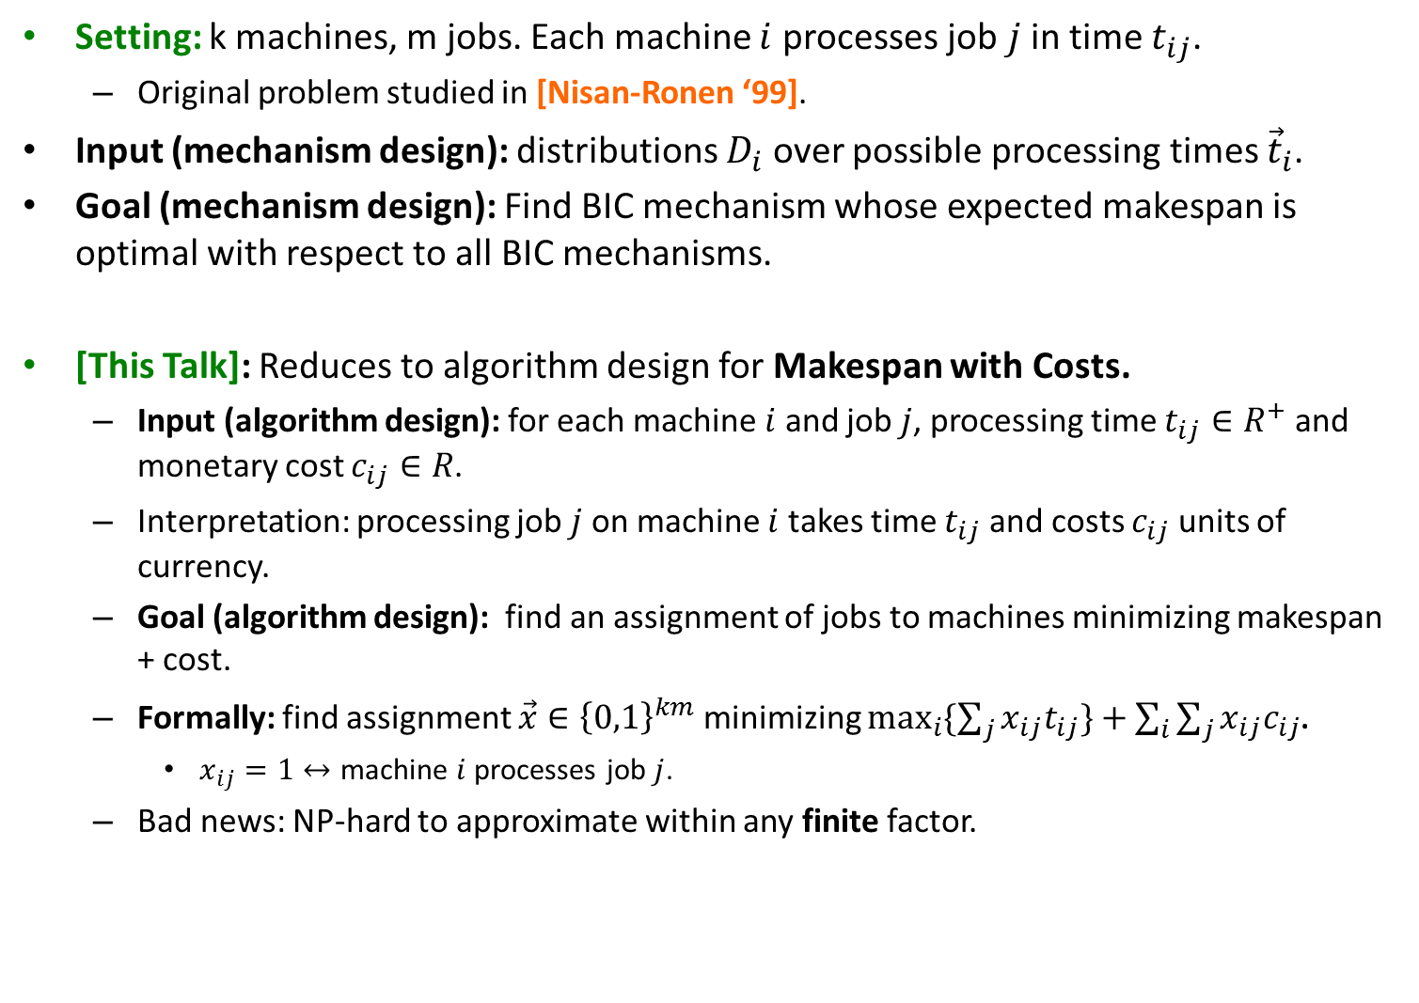
Truthful Job Scheduling on Unrelated Machines
Setting: k machines, m jobs. Each machine $i$ processes job $j$ in time $t_{ij}$.
Original problem studied in [Nisan-Ronen ‘99].
Input (mechanism design): distributions $D_{i}$ over possible processing times ${\vec{t}}_{i}$.
Goal (mechanism design): Find BIC mechanism whose expected makespan is optimal with respect to all BIC mechanisms.
[This Talk]: Reduces to algorithm design for Makespan with Costs.
Input (algorithm design): for each machine $i$ and job $j$, processing time $t_{ij}∈R^{+}$ and monetary cost $c_{ij}∈R$.
Interpretation: processing job $j$ on machine $i$ takes time $t_{ij}$ and costs $c_{ij}$ units of currency.
Goal (algorithm design): find an assignment of jobs to machines minimizing makespan + cost.
Formally: find assignment $\vec{x}∈{\left\{0,1\right\}}^{km}$ minimizing $\max_{i}{\{\sum_{j}{x_{ij}t_{ij}\}+\sum_{i}{\sum_{j}{x_{ij}c_{ij}}}}}$.
$x_{ij}=1↔$ machine $i$ processes job $j$.
Bad news: NP-hard to approximate within any finite factor.

Slide 51
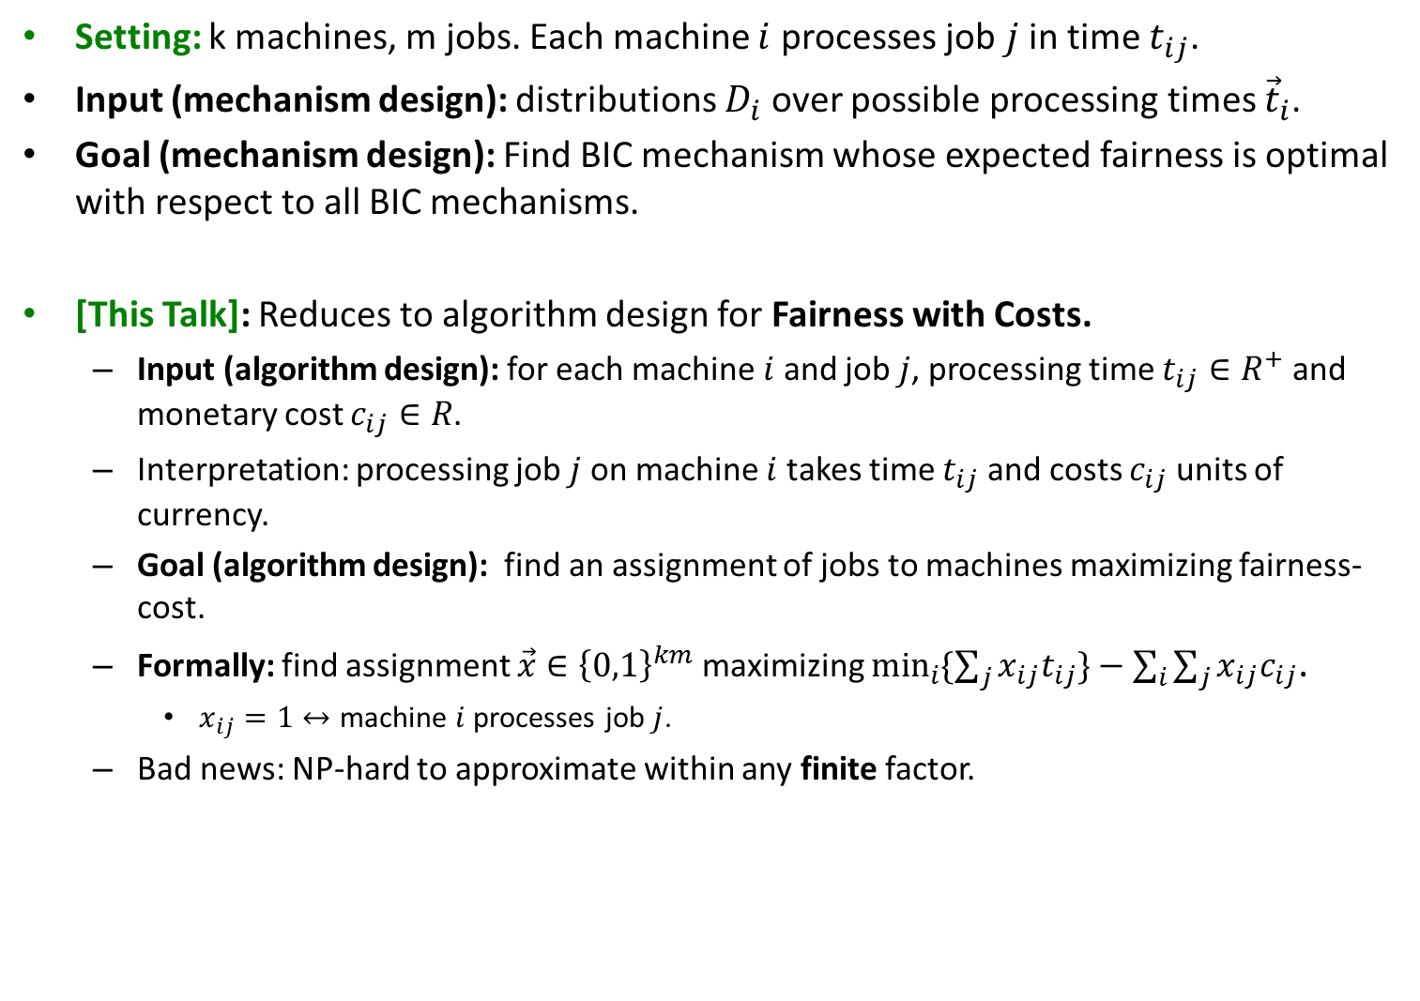
Truthful Fair Allocation of Indivisible Goods
Setting: k machines, m jobs. Each machine $i$ processes job $j$ in time $t_{ij}$.
Input (mechanism design): distributions $D_{i}$ over possible processing times ${\vec{t}}_{i}$.
Goal (mechanism design): Find BIC mechanism whose expected fairness is optimal with respect to all BIC mechanisms.
[This Talk]: Reduces to algorithm design for Fairness with Costs.
Input (algorithm design): for each machine $i$ and job $j$, processing time $t_{ij}∈R^{+}$ and monetary cost $c_{ij}∈R$.
Interpretation: processing job $j$ on machine $i$ takes time $t_{ij}$ and costs $c_{ij}$ units of currency.
Goal (algorithm design): find an assignment of jobs to machines maximizing fairness- cost.
Formally: find assignment $\vec{x}∈{\left\{0,1\right\}}^{km}$ maximizing $\min_{i}{\{\sum_{j}{x_{ij}t_{ij}\}−\sum_{i}{\sum_{j}{x_{ij}c_{ij}}}}}$.
$x_{ij}=1↔$ machine $i$ processes job $j$.
Bad news: NP-hard to approximate within any finite factor.

Slide 52
What Now?
Framework not (yet) general enough to accommodate makespan and fairness.
Because NP-hard to approximately optimize O + virtual welfare.
But these problems do admit some form of bi-criterion approximations.
Defined shortly.
Goal: Extend framework to accommodate specific notion of bi-criterion approximation as well.

Slide 53
Bi-Criterion Approximations

Slide 54
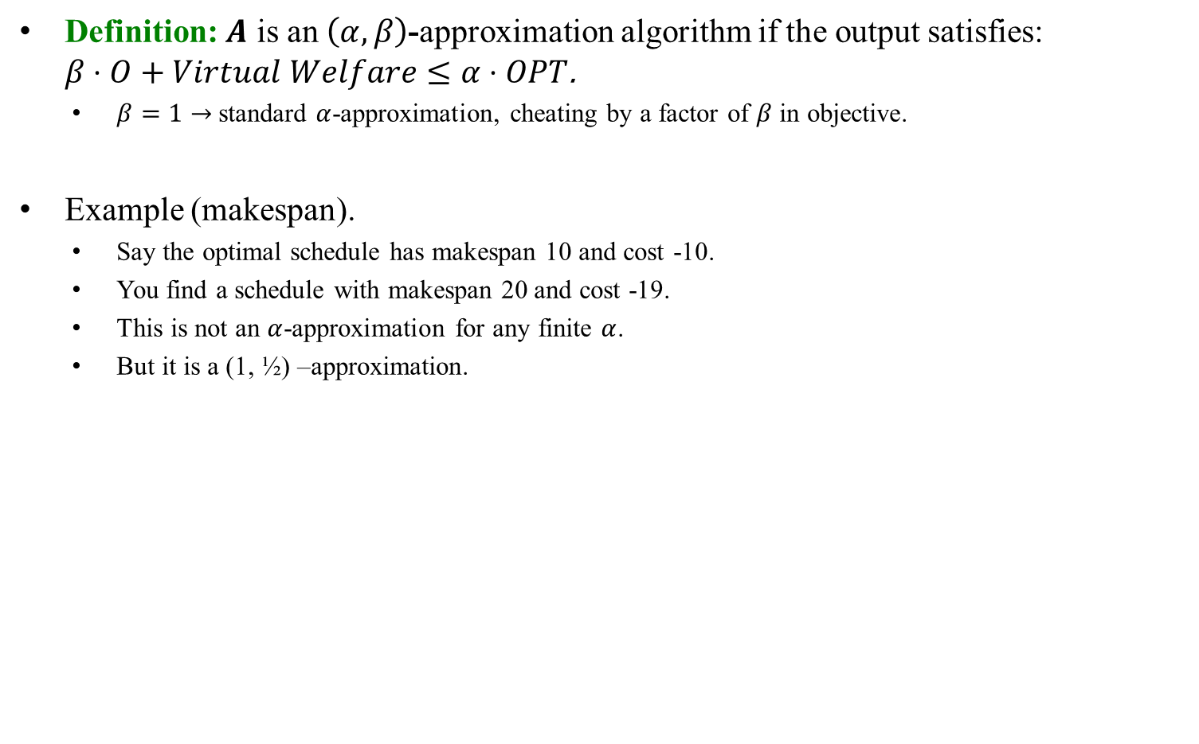

$\left(α,β\right)$-Approximations
Definition: $A$ is an $\left(α,β\right)$-approximation algorithm if the output satisfies: $β⋅O+Virtual Welfare≤α⋅OPT$.
$β=1→$ standard $α$-approximation, cheating by a factor of $β$ in objective.
Example (makespan).
Say the optimal schedule has makespan 10 and cost -10.
You find a schedule with makespan 20 and cost -19.
This is not an $α$-approximation for any finite $α$.
But it is a (1, ½) –approximation.

Slide 55
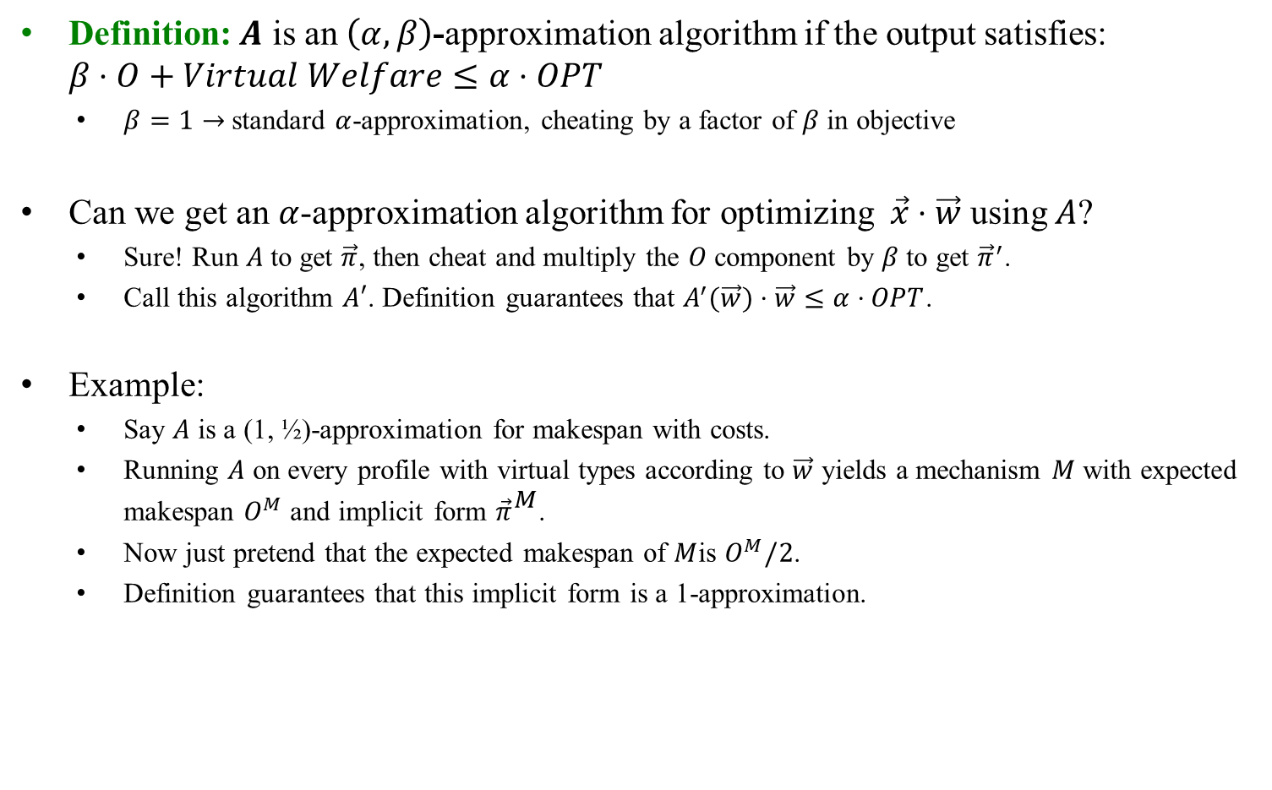
$\left(α,β\right)$-Approximations
Definition: $A$ is an $\left(α,β\right)$-approximation algorithm if the output satisfies: $β⋅O+Virtual Welfare≤α⋅OPT$
$β=1→$ standard $α$-approximation, cheating by a factor of $β$ in objective
Can we get an $α$-approximation algorithm for optimizing $\vec{x}⋅\vec{w}$using $A$?
Sure! Run $A$ to get $\vec{π}$, then cheat and multiply the $O$ component by $β$to get ${\vec{π}}^{′}$.
Call this algorithm $A′$. Definition guarantees that $A_{}^{′}(\vec{w})⋅\vec{w}≤α⋅OPT$.
Example:
Say $A$ is a (1, ½)-approximation for makespan with costs.
Running $A$ on every profile with virtual types according to $\vec{w}$ yields a mechanism $M$ with expected makespan $O^{M}$ and implicit form ${\vec{π}}^{M}$.
Now just pretend that the expected makespan of $M$is $O^{M}/2$.
Definition guarantees that this implicit form is a 1-approximation.

Slide 56
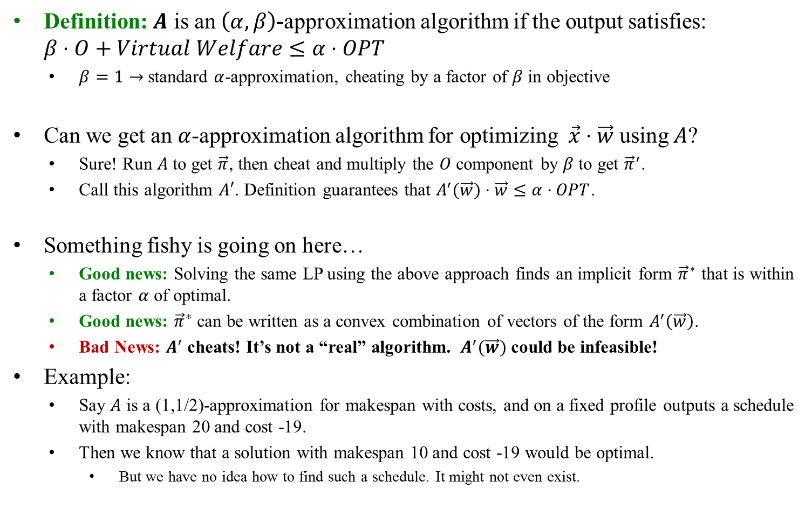
$\left(α,β\right)$-Approximations
Definition: $A$ is an $\left(α,β\right)$-approximation algorithm if the output satisfies: $β⋅O+Virtual Welfare≤α⋅OPT$
$β=1→$ standard $α$-approximation, cheating by a factor of $β$ in objective
Can we get an $α$-approximation algorithm for optimizing $\vec{x}⋅\vec{w}$using $A$?
Sure! Run $A$ to get $\vec{π}$, then cheat and multiply the $O$ component by $β$to get ${\vec{π}}^{′}$.
Call this algorithm $A′$. Definition guarantees that $A_{}^{′}(\vec{w})⋅\vec{w}≤α⋅OPT$.
Something fishy is going on here…
Good news: Solving the same LP using the above approach finds an implicit form ${\vec{π}}^{∗}$ that is within a factor $α$ of optimal.
Good news: ${\vec{π}}^{∗}$ can be written as a convex combination of vectors of the form $A_{}^{′}\left(\vec{w}\right)$.
Bad News: $A^{′}$ cheats! It’s not a “real” algorithm. ${ A}_{}^{′}(\vec{w})$ could be infeasible!
Example:
Say $A$ is a (1,1/2)-approximation for makespan with costs, and on a fixed profile outputs a schedule with makespan 20 and cost -19.
Then we know that a solution with makespan 10 and cost -19 would be optimal.
But we have no idea how to find such a schedule. It might not even exist.

Slide 57
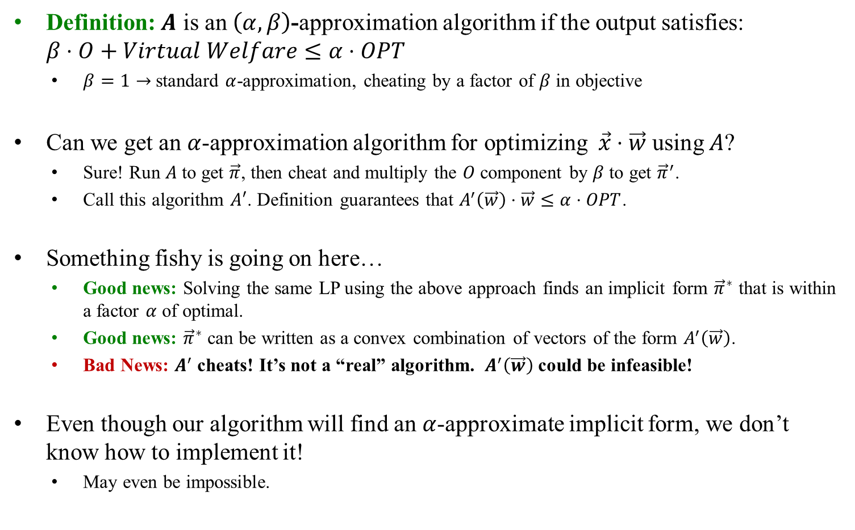
$\left(α,β\right)$-Approximations
Definition: $A$ is an $\left(α,β\right)$-approximation algorithm if the output satisfies: $β⋅O+Virtual Welfare≤α⋅OPT$
$β=1→$ standard $α$-approximation, cheating by a factor of $β$ in objective
Can we get an $α$-approximation algorithm for optimizing $\vec{x}⋅\vec{w}$using $A$?
Sure! Run $A$ to get $\vec{π}$, then cheat and multiply the $O$ component by $β$to get ${\vec{π}}^{′}$.
Call this algorithm $A′$. Definition guarantees that $A_{}^{′}\left(\vec{w}\right)⋅\vec{w}≤α⋅OPT$.
Something fishy is going on here…
Good news: Solving the same LP using the above approach finds an implicit form ${\vec{π}}^{∗}$ that is within a factor $α$ of optimal.
Good news: ${\vec{π}}^{∗}$ can be written as a convex combination of vectors of the form $A_{}^{′}\left(\vec{w}\right)$.
Bad News: $A^{′}$ cheats! It’s not a “real” algorithm. ${ A}_{}^{′}\left(\vec{w}\right)$ could be infeasible!
Even though our algorithm will find an $α$-approximate implicit form, we don’t know how to implement it!
May even be impossible.

Slide 58
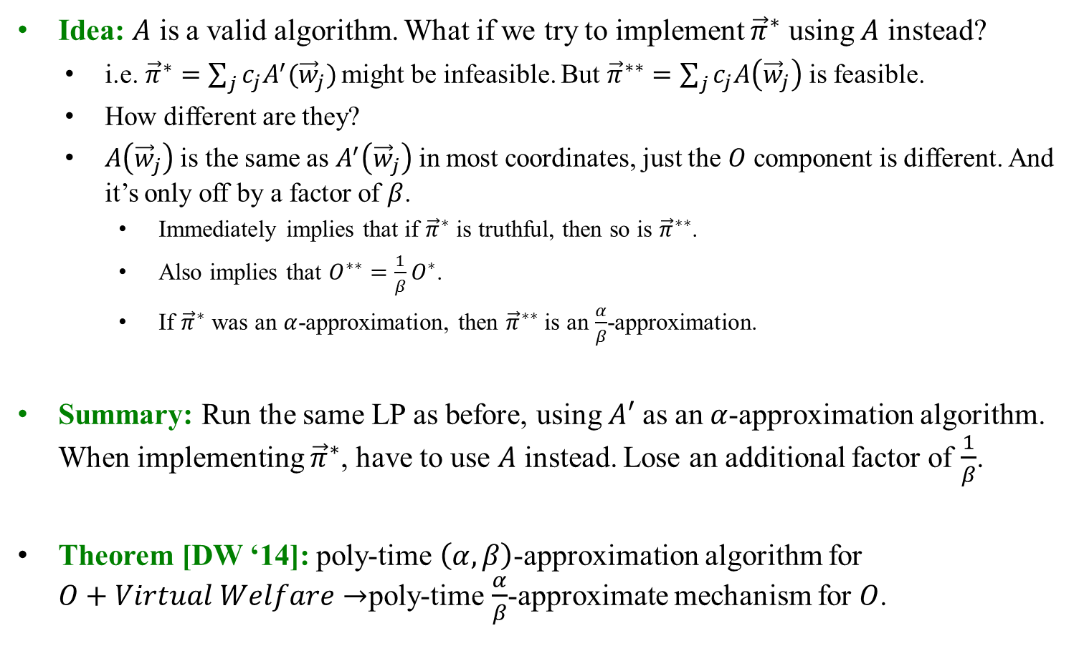
$\left(α,β\right)$-Approximations
Idea: $A$ is a valid algorithm. What if we try to implement ${\vec{π}}^{∗}$ using $A$ instead?
i.e.${\vec{π}}^{∗}=\sum_{j}{c_{j}A_{}^{′}({\vec{w}}_{j})}$ might be infeasible. But ${\vec{π}}^{∗∗}=\sum_{j}{c_{j}A\left({\vec{w}}_{j}\right)}$ is feasible.
How different are they?
$A\left({\vec{w}}_{j}\right)$ is the same as $A_{}^{′}\left({\vec{w}}_{j}\right)$ in most coordinates, just the $O$ component is different. And it’s only off by a factor of $β$.
Immediately implies that if ${\vec{π}}^{∗}$ is truthful, then so is ${\vec{π}}^{∗∗}$.
Also implies that $O^{∗∗}=\frac{1}{β}O^{∗}$.
If ${\vec{π}}^{∗}$ was an $α$-approximation, then ${\vec{π}}^{∗∗}$ is an $\frac{α}{β}$-approximation.
Summary: Run the same LP as before, using $A′$ as an $α$-approximation algorithm. When implementing ${\vec{π}}^{∗}$, have to use $A$ instead. Lose an additional factor of $\frac{1}{β}$.
Theorem [DW ‘14]: poly-time $\left(α,β\right)$-approximation algorithm for $O+Virtual Welfare→$poly-time $\frac{α}{β}$-approximate mechanism for $O$.

Slide 59
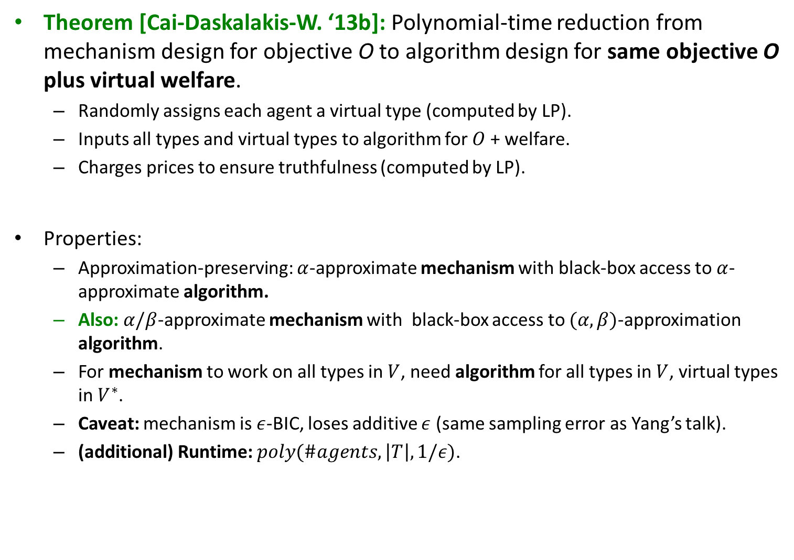
Main Result
Theorem [Cai-Daskalakis-W. ‘13b]: Polynomial-time reduction from mechanism design for objective O to algorithm design for same objective O plus virtual welfare.
Randomly assigns each agent a virtual type (computed by LP).
Inputs all types and virtual types to algorithm for $O$ + welfare.
Charges prices to ensure truthfulness (computed by LP).
Properties:
Approximation-preserving: $α$-approximate mechanism with black-box access to $α$-approximate algorithm.
Also: $α/β$-approximate mechanism with black-box access to $(α, β)$-approximation algorithm.
For mechanism to work on all types in $V$, need algorithm for all types in $V$, virtual types in $V^{∗}$.
Caveat: mechanism is $ε$-BIC, loses additive $ε$ (same sampling error as Yang’s talk).
(additional) Runtime: $poly(\#agents,\left|T\right|, 1/ε)$.

Slide 60
Let’s Apply It!

Slide 61
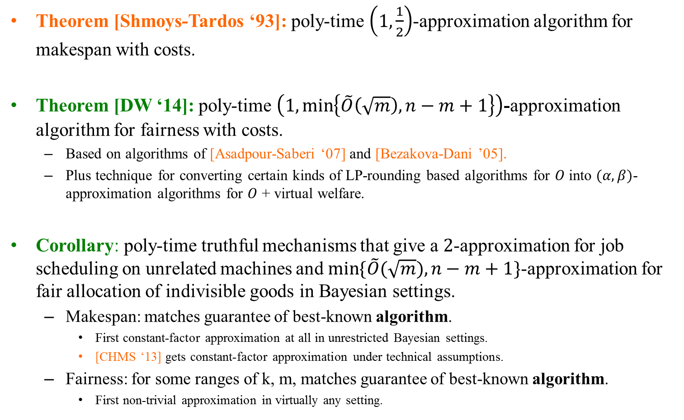
$\left(α,β\right)$-Approximations
Theorem [Shmoys-Tardos ‘93]: poly-time $\left(1,\frac{1}{2}\right)$-approximation algorithm for makespan with costs.
Theorem [DW ‘14]: poly-time $\left(1,\min\left\{\tilde{O}\left(\sqrt{m}\right), n−m+1\right\}\right)$-approximation algorithm for fairness with costs.
Based on algorithms of [Asadpour-Saberi ‘07] and [Bezakova-Dani ’05].
Plus technique for converting certain kinds of LP-rounding based algorithms for $O$ into $(α, β)$-approximation algorithms for $O$ + virtual welfare.
Corollary: poly-time truthful mechanisms that give a $2$-approximation for job scheduling on unrelated machines and $\min{\{\tilde{O}(\sqrt{m}}),n−m+1\}$-approximation for fair allocation of indivisible goods in Bayesian settings.
Makespan: matches guarantee of best-known algorithm.
First constant-factor approximation at all in unrestricted Bayesian settings.
[CHMS ‘13] gets constant-factor approximation under technical assumptions.
Fairness: for some ranges of k, m, matches guarantee of best-known algorithm.
First non-trivial approximation in virtually any setting.

Slide 62
Conclusions

Slide 63
Conclusions: Revenue
[Myerson ’81]:
In single-dimensional settings, the revenue-optimal auction is a virtual welfare-maximizer.
Major Open Question:
What does the revenue-optimal auction look like beyond single-dimensional settings?
[Costis + Yang]: No matter what the bidders’ types, the revenue-optimal auction is a distribution over virtual welfare-maximizers.

Slide 64
Conclusions: Revenue
Costis’ Talk:
Optimal multi-dimensional mechanism: additive bidders, no constraints.
(randomly) Assigns virtual values to each agent for each item (computed by LP).
Awards each item to highest virtual bidder.
Charges prices to ensure truthfulness (computed by LP).
Yang’s Talk:
Optimal multi-dimensional mechanism: arbitrary bidders & constraints.
(randomly) Assigns each agent a virtual type (computed by LP).
Virtual types will be linear combinations of possible types.
Selects outcome that optimizes virtual welfare.
Charges prices to ensure truthfulness (computed by LP).

Slide 65
Conclusions: Non-Linear Objectives
[Nisan-Ronen ’99]:
How much more difficult are optimization problems on “strategic” input compared to “honest” input?
Major Open Question:
For what (if any) optimization problems is there a reduction from mechanism- to algorithm-design?
“strategic inputs”
“honest inputs”
[This Talk]: For all objectives in a Bayesian setting, reduction exists (with perturbed objective).
“Transitioning from honest to strategic input is no more computationally difficult than adding welfare to objective.”

Slide 66
Conclusions: Non-Linear Objectives
Theorem [Cai-Daskalakis-W. ‘13b]: Polynomial-time reduction from mechanism design for objective O to algorithm design for same objective O plus virtual welfare.
Randomly assigns each agent a virtual type (computed by LP).
Inputs all types and virtual types to algorithm for $O$ + welfare.
Charges prices to ensure truthfulness (computed by LP).
Properties:
Approximation-preserving: $α$-approximate mechanism with black-box access to $α$-approximate algorithm.
Also: $α/β$-approximate mechanism with black-box access to $(α, β)$-approximation algorithm.
For mechanism to work on all types in $V$, need algorithm for all types in $V$, virtual types in $V^{∗}$.
Caveat: mechanism is $ε$-BIC, loses additive $ε$ (same sampling error as Yang’s talk).
(additional) Runtime: $poly(\#agents,\left|T\right|, 1/ε)$.

Slide 67
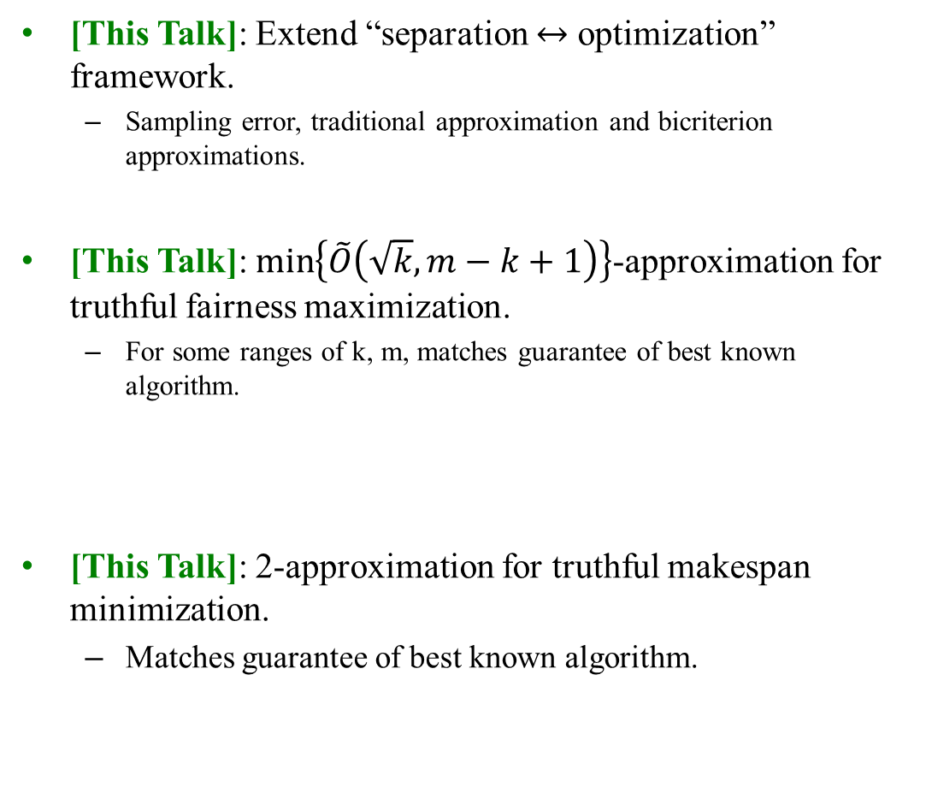
Conclusions: Contributions
[This Talk]: Extend “separation $↔$ optimization” framework.
Sampling error, traditional approximation and bicriterion approximations.
[This Talk]: $\min\left\{\tilde{O}\left(\sqrt{k},m−k+1\right)\right\}$-approximation for truthful fairness maximization.
For some ranges of k, m, matches guarantee of best known algorithm.
[This Talk]: 2-approximation for truthful makespan minimization.
Matches guarantee of best known algorithm.
“Yes”

Slide 68
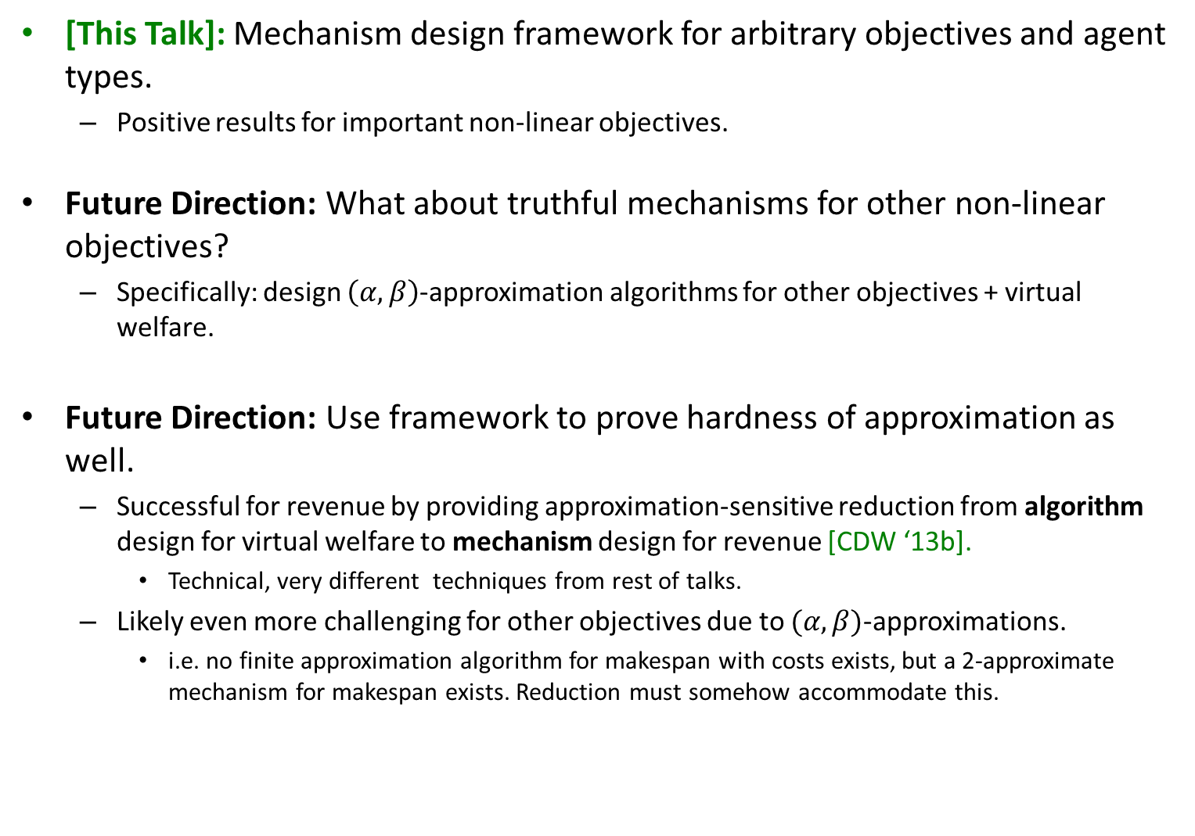
Conclusions: Future Work
[This Talk]: Mechanism design framework for arbitrary objectives and agent types.
Positive results for important non-linear objectives.
Future Direction: What about truthful mechanisms for other non-linear objectives?
Specifically: design $\left(α, β\right)$-approximation algorithms for other objectives + virtual welfare.
Future Direction: Use framework to prove hardness of approximation as well.
Successful for revenue by providing approximation-sensitive reduction from algorithm design for virtual welfare to mechanism design for revenue [CDW ‘13b].
Technical, very different techniques from rest of talks.
Likely even more challenging for other objectives due to $(α,β)$-approximations.
i.e. no finite approximation algorithm for makespan with costs exists, but a 2-approximate mechanism for makespan exists. Reduction must somehow accommodate this.

Slide 69
Conclusions: Future Work
Many interesting comparisons of mechanisms to algorithms:
[This Talk]: Framework for designing computationally efficient BIC mechanisms that are competitive with the optimal BIC mechanism.
Another direction [Nisan-Ronen ’99]: Quantify the gap between the performance of the optimal BIC mechanism and that of the optimal algorithm.
Our framework provides a useful computational tool.

Slide 70
Thanks for listening!

